Slide 1

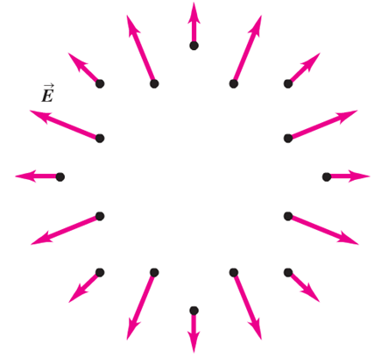


Gauss’s law
Can we find a simplified way to perform electric-field calculations
Yes, we take advantage of a fundamental relationship between electric charge and electric field: Gauss’s law
So far we considered problems like this:
charge distribution given
what is the resulting E-field
what is the underlying charge distribution
Now: E-field given
Thought experiment:
We detect an electric field
outside the Gauss surface
and can conclude
Let’s assume we have a closed container, e.g., a sphere of an imaginary material that doesn’t interact with an electric field
There must be a charge inside

Slide 2
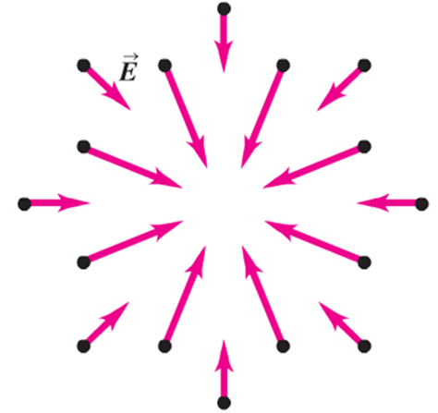

We can even be quantitative about the charge inside the Gauss volume
The same number of field lines
on the surface point into the Gauss
volume as there a field line pointing
out
We say in this case
the net electric flux is zero

Slide 3


Electric flux
Flux ( from Latin fluxus meaning flow):
is generally speaking the scalar quantity, φ, which results from a surface integration over a vector field.
In the case of electric flux, φ_{E}, the vector field is the electric E-field and the surface is the surface of the Gauss volume
Don’t panic,
we break it down into simple intuitive steps
Let’s consider the intuitive velocity vector field of a fluid flowing in a pipe
The flux φ_{v} of the velocity vector field v through the surface of area A reads
v
A

Slide 4
Let’s interpret
v
A
Volume element of fluid which flows through surface A in time dt
volume flow rate through A
What if we tilt A
Extreme case:
A
v
Flux through A is zero

Slide 5
If we tilt area by an angle ϕ
v
A
ϕ
A is a vector with the properties:
pointing normal to the surface
surface area
Finally if surface is curved the orientation of A changes on the surface and we generalize
into
also change of v on the surface is taken care of

Slide 6
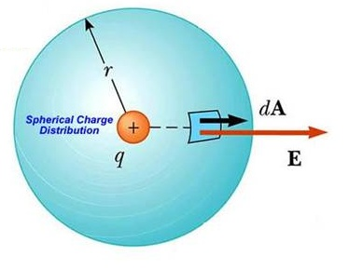
The electric flux is defined in complete analogy
Let’s systematically approach the general form of Gauss’s law by considering
a sequence of examples with increasing generality
The electric flux of a point charge inside a Gauss sphere
Spherical Gauss surface
Note that the surface is closed
We are going to calculate:
indicates that we integrate over a closed surface
The symmetry of the problem makes the
integration simple:
E is perpendicular to the surface and its magnitude is the same at each point of the surface

Slide 7
Clicker question
Considering the result obtained from calculating the electric flux of a point charge through a Gauss sphere. Do you expect that the flux depends on the radius of the sphere?
Yes, the larger the radius the more flux lines will penetrate through
the surface
B) No, the flux is independent of the radius
C) I have to calculate again for a different radius

Slide 8
result does not depend on the radius of the Gauss sphere
More generally the result of the integral does not depend on the specific
form of the surface, only on the amount of charge enclosed by the surface.
For example we can calculate the flux of the enclosed charge Q through the surface of a cube
z
The box geometry suggests the use of Cartesian
Coordinates:
y
a
x

Slide 9
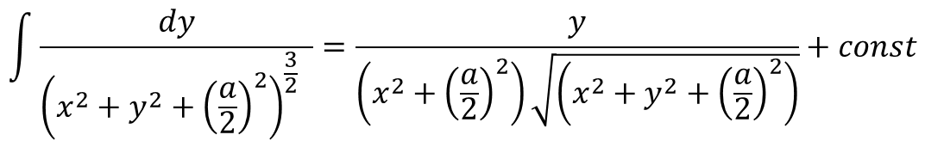
With
$$\int{\frac{dy}{{\left(x^{2}+y^{2}+{\left(\frac{a}{2}\right)}^{2}\right)}^{\frac{3}{2}} }=\frac{y}{\left(x^{2}+{\left(\frac{a}{2}\right)}^{2}\right)\sqrt{\left(x^{2}+y^{2}+{\left(\frac{a}{2}\right)}^{2}\right)}}+const}$$

Slide 10
And with
Our considerations suggest:
Flux through any surface enclosing the charge Q is given by Q/ε₀

Slide 11
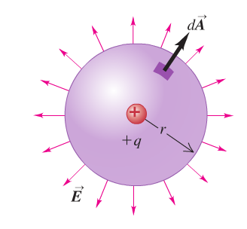
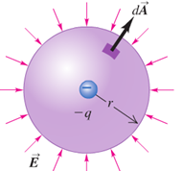
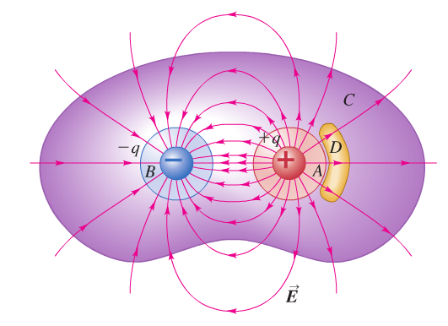
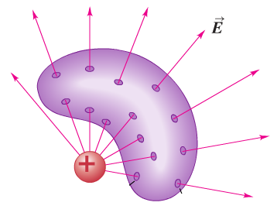
Let’s summarize findings into the general form of Gauss’s law
The total electric flux through a closed surface is equal to the
total (net) electric charge inside the surface divided by ε₀
Images from our textbook Young and Freedman, University Press

Slide 12
Electric field within a charged conductor
This brief consideration prepares us for an experimental test of Gauss’s law
Necessary condition for electrostatic equilibrium
because otherwise charge flows
without these charges -q
there would be flux through
Gauss surface
q_{c}+q
+
+
+
+
+
+
+
+
+
+
+
-
-
+
+
+
+
-
+
+
-
+
E=0
+
+
-
+
+
-
+
+
+
+
-
-
-
+
+
+
+
+
+
+
+
+
+
+
+
+
+
+
+
+
+
+
+
+
+
+
+
+
+
Gaussian surface
E=0 everywhere on the surface
Solid conductor with charge q_{c}

Slide 13
Experimental test of Gauss’s law

Slide 14
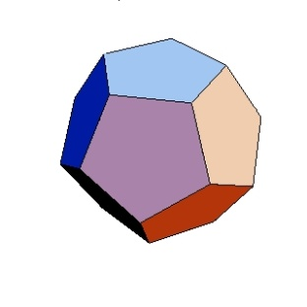
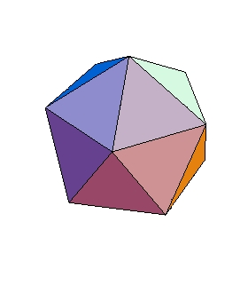
Clicker question
Consider the conducting solid with a cavity again. We place a conducting charged sphere into the cavity and let this sphere touch the surface of the cavity.
What do you expect will happen?
A) The sphere remains charged
B) The sphere creates a dipole moment
C) The charge of the sphere will flow from the
sphere and accumulate at the surface of the conducting
solid
D) The sphere will spontaneously transform into a
dodecahedron
E) The sphere will spontaneously transform into an icosahedron
+
+
+
+
+
+
+
+
+
+
+
+
+
+
+
+
+
+
+
+
+
+
+
+
+
+

