Slide 1

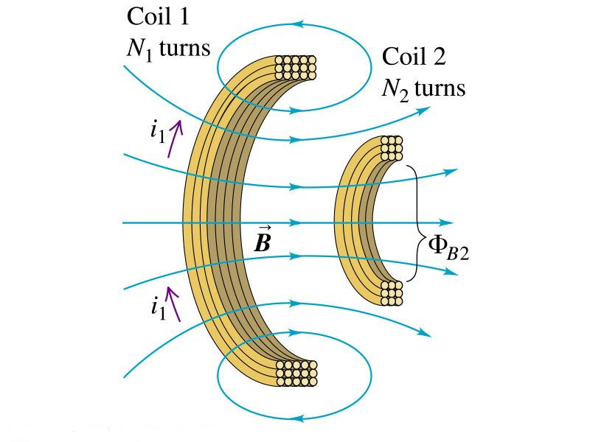






Inductance
We know already: changing magnetic flux creates an emf
changing current in a coil will induce a current in an adjacent coil
Coupling between coils is described by mutual inductance
$$N_{2}Φ_{B_{2}}=M_{21}i_{1}$$
mutual inductance
Current i₁ through coil 1 creates B-field and thus flux through coil 2.
If i₁=i₁(t) then dB/dt  0 and thus d/dt  0 inducing an emf in coil2.
From
$$N_{2}Φ_{B_{2}}=M_{21}i_{1}$$
$$N_{2}\frac{dΦ_{B_{2}}}{dt}=M_{21}\frac{di_{1}}{dt}$$
Using
For vacuum and material with constant susceptibility
M₂₁ is a constant and given by
$$ℰ_{2}=−N_{2}\frac{dΦ_{B_{2}}}{dt}$$
$$ℰ_{2}=−M_{21}\frac{di_{1}}{dt}$$
$$M_{21}=\frac{N_{2}Φ_{B_{2}}}{i_{1}}$$

Slide 2







Repeating the thought by driving a time dependent current, $i_{2}$, through coil 2
$$ℰ_{1}=−M_{12}\frac{di_{2}}{dt}$$
Induction of emf $ℰ_{1}$ in coil 1
$$ℰ_{1}=−M_{12}\frac{di_{2}}{dt}$$
with
$$M_{12}=\frac{N_{1}Φ_{B_{1}}}{i_{2}}$$
$$ℰ_{2}=−M_{21}\frac{di_{1}}{dt}$$
with
$$M_{21}=\frac{N_{2}Φ_{B_{2}}}{i_{1}}$$
For the vacuum case (but also in general) mutual inductance depends only on coil geometry
$$M_{12}=M_{21}=M$$
with
$$M=\frac{N_{1}Φ_{B_{1}}}{i_{2}}=\frac{N_{2}Φ_{B_{2}}}{i_{1}}$$
Mutual inductance is measured in Henry where 1H=1Wb/A=1Vs/A=1Ωs=1J/A²
- Mutual inductance can give rise to cross-talk in electronic circuits ☹
- Mutual inductance has important applications, e.g., in transformers ☺

Slide 3
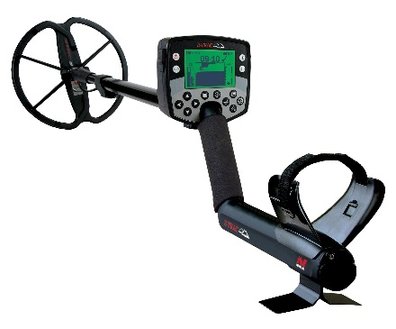
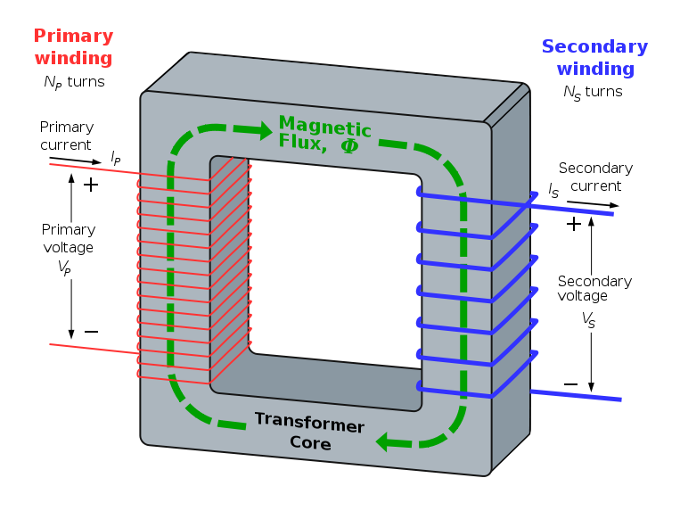
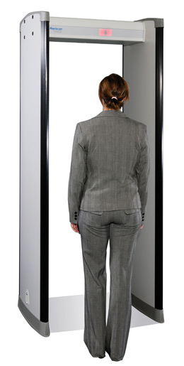
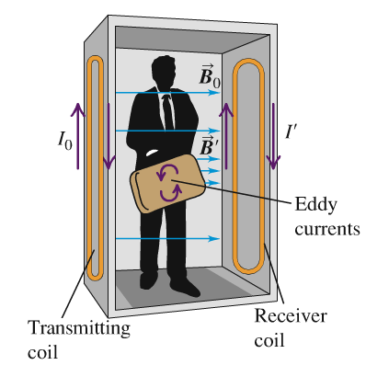
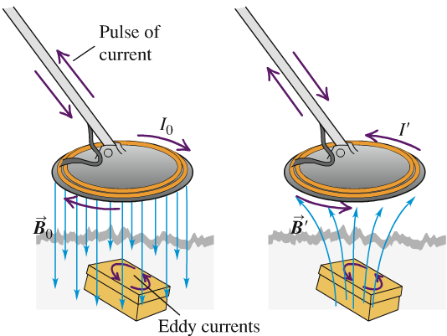
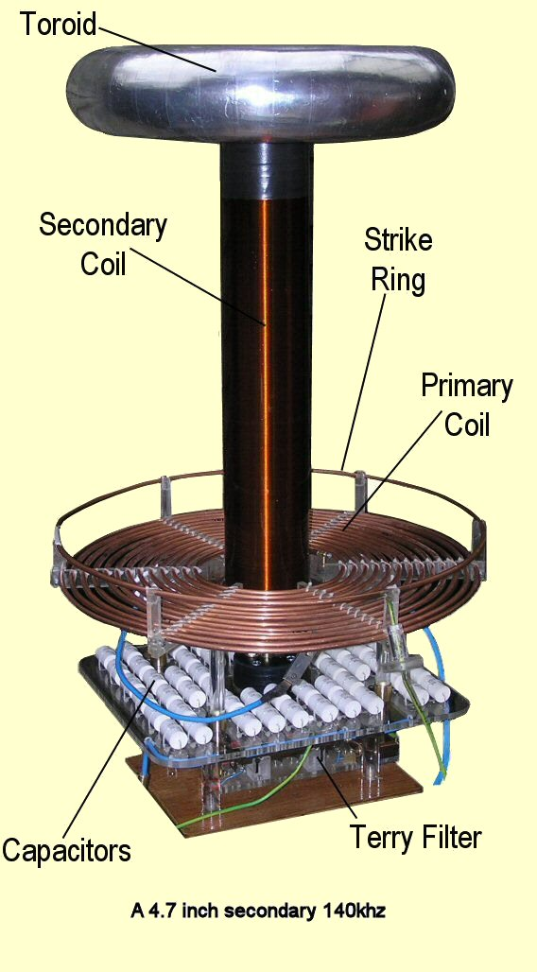
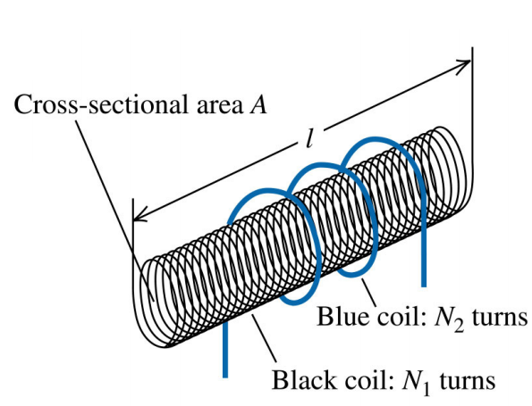



Many applications happen in AC circuits (see textbook).
Here a collection:
Transformers
Metal detectors
Here we have a brief look at the Tesla coil
Current i₁ through coil 1 creates B-field
$$B_{1}=\frac{μ_{0}i_{1}N_{1}}{l}$$
and flux
$$Φ_{1}=B_{1}A=Φ_{2}$$
solenoid 1 is long compared to solenoid 2
$$M=\frac{N_{2}Φ_{B_{2}}}{i_{1}}=\frac{μ_{0}N_{1}N_{2}A}{l}$$
M depends only on geometry and in particular on product N₁N₂.

Slide 4
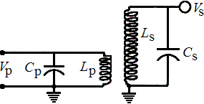
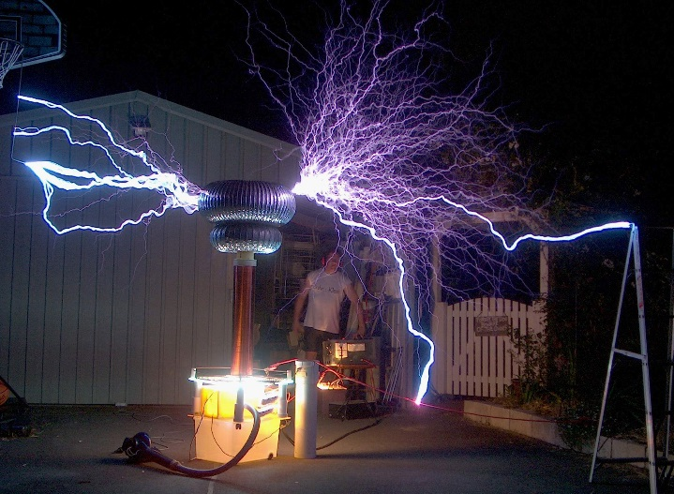
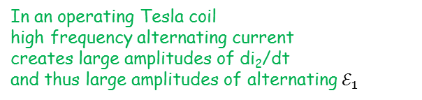

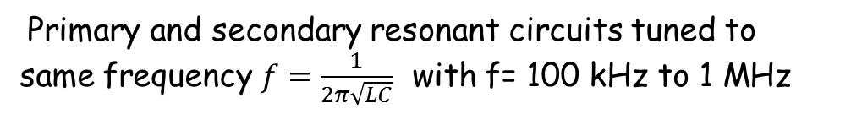

To see how a Tesla coil can create a vary large emf let’s have a look to
an example
Drive a current i₂(t)through solenoid 2 (blue)
$$Φ_{B_{1}}=\frac{Mi_{2}}{N_{1}}$$
Flux through solenoid 1 is given by
emf induced in solenoid 1 reads:
$$ℰ_{1}=−M\frac{di_{2}}{dt}$$
In an operating Tesla coil
high frequency alternating current
creates large amplitudes of di₂/dt
and thus large amplitudes of alternating $ℰ_{1}$
Primary and secondary resonant circuits tuned to same frequency $f=\frac{1}{2π\sqrt{LC}}$ with f= 100 kHz to 1 MHz
see slide 11 for derivation of resonance frequency
in LC-circuit
Hallmark of Tesla coil is the loose/critical coupling (large air gap) between the solenoids 1 and 2 to prevent damage (insulation between tightly coupled solenoids would experience dielectric breakdown).
Note, I did not check
the scientific validity
of the information
provided on this
web-site
From
http://tesladownunder.com/Tesla_coils_intro.htm

Slide 5
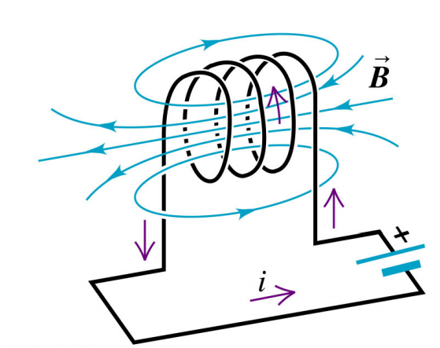
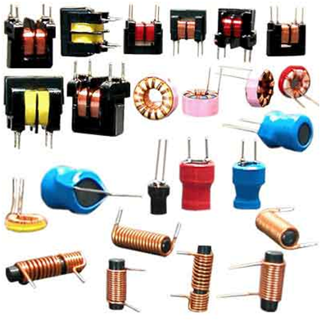
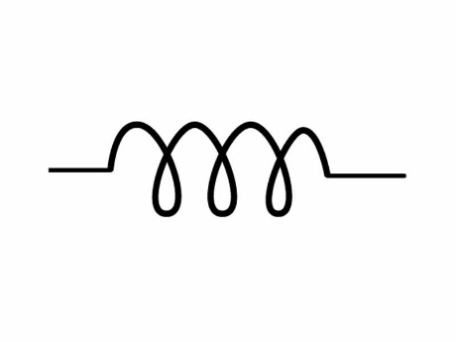



Self-Inductance and Inductors
The concept that a changing flux induces an emf can also be applied in the case of a single solenoid
Self-inductance
$$L=\frac{N Φ}{i}$$
With
$$ℰ_{}=−N\frac{dΦ}{dt}$$
$$ℰ_{}=−L\frac{di}{dt}$$
A device designed to have a particular inductance L is called an inductor
Circuit symbol
Examples from http://upload.wikimedia.org/wikipedia/commons/2/27/Aplikimi_i_feriteve.png

Slide 6
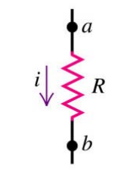
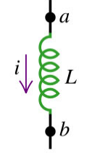
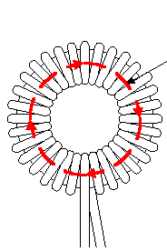




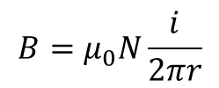


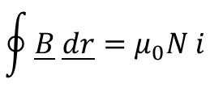

The effect of an inductor in a circuit
Let’s compare resistor and inductor
Current flowing through resistor R
gives rise to potential drop
Emf
$$ℰ_{}=−L\frac{di}{dt}$$
opposes current change
$$V_{ab}=iR$$
$$V_{ab}=L\frac{di}{dt}$$
Potential drop
Note: Sign opposite to emf
Example: Inductance of an air core toroidal solenoid
1) Determine B from Ampere’s law
$$\oint{\underline{B} \underline{dr}=μ_{0}N i}$$
$$B=μ_{0}N\frac{i}{2πr}$$
r
$$Φ=BA=μ_{0}\frac{NAi}{2πr}$$
2) Determine flux through one loop
3) Determine emf of solenoid and compare with
$$ℰ_{}=−L\frac{di}{dt}$$
$$ℰ_{}=−N\frac{dΦ}{dt}=−μ_{0}\frac{N^{2}A}{2πr}\frac{di}{dt}$$
$$L=μ_{0}\frac{N^{2}A}{2πr}$$

Slide 7


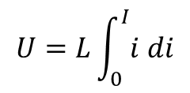
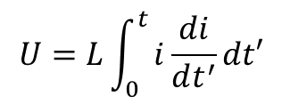
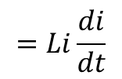

Magnetic field Energy
We will see that similar to the electric field there is energy stored in a magnetic field
Energy stored in an Inductor
Let’s calculate the energy input U needed to establish a current I in an ideal (zero resistance) inductor with inductance L
With
$$V_{ab}=L\frac{di}{dt}$$
we obtain for the power, P, delivered to the inductor
$$P=V_{ab}i$$
$$=Li\frac{di}{dt}$$
$$U=L\int_{0}^{t}{i\frac{di}{dt^{′}}dt′}$$
For the energy delivered after time, t, we obtain
Changing integration variable from t to i we obtain
$$U=L\int_{0}^{I}{i di}$$
$$=\frac{1}{2}LI^{2}$$
Energy stored in an inductor when permanent current I is flowing

Slide 8
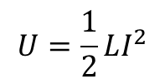
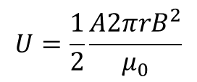
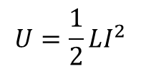

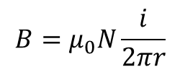
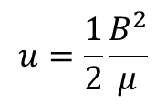
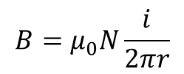

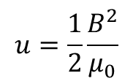
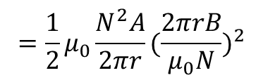

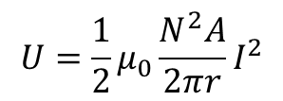
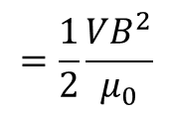
We now want to use
$$U=\frac{1}{2}LI^{2}$$
to see that the energy is stored in the field
(very much in analogy to the transition from energy in a capacitor to energy stored in the electric field)
Let’s recall the inductance L of a toroidal inductor
$$L=μ_{0}\frac{N^{2}A}{2πr}$$
$$B=μ_{0}N\frac{i}{2πr}$$
Volume, V, which is filled with a magnetic field of magnitude
V$=2 πr A$
where A is the area of the cross-section
$$L=μ_{0}\frac{N^{2}A}{2πr}$$
$$B=μ_{0}N\frac{i}{2πr}$$
for i=I
$$U=\frac{1}{2}LI^{2}$$
$$U=\frac{1}{2}μ_{0}\frac{N^{2}A}{2πr}I^{2}$$
$$=\frac{1}{2}μ_{0}\frac{N^{2}A}{2πr}{(\frac{2πrB}{μ_{0}N})}^{2}$$
The energy
can be expressed as
$$U=\frac{1}{2}\frac{A2πrB^{2}}{μ_{0}}$$
$$=\frac{1}{2}\frac{VB^{2}}{μ_{0}}$$
which yields the energy density u=U/V
$$u=\frac{1}{2}\frac{B^{2}}{μ_{0}}$$
$$u=\frac{1}{2}\frac{B^{2}}{μ}$$
for vacuum or
in a magnetic material

Slide 9
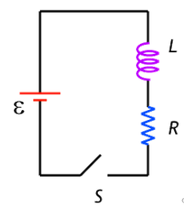


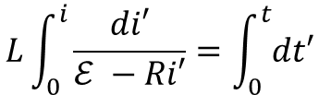


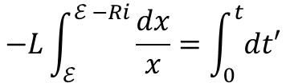


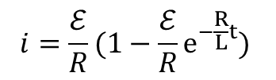
R-L circuits
$$ℰ −Ri−L\frac{di}{dt}=0$$
Kirchhoff’s loop rule
t=0 is time when switch is closed all the voltage drops across L and thus i(t=0)=0
For$t→ ∞$ I becomes stationary and is limited only by R
$$I=\frac{ℰ}{R}$$
$$L\int_{0}^{i}{\frac{di′}{ℰ −Ri′}}=\int_{0}^{t}{dt′}$$
Solving the differential equation:
Substitution $x=ℰ −Ri$yields
$$dx=−Rdi$$
$$−L\int_{ℰ }^{ℰ −Ri}{\frac{dx}{x}}=\int_{0}^{t}{dt′}$$
$$\frac{−L}{R}ln\frac{ℰ −Ri}{ℰ}=t$$
$$ℰ −Ri=ℰe^{−\frac{R}{L}t}$$
$$i=\frac{ℰ}{R}(1−\frac{ℰ}{R}e^{−\frac{R}{L}t})$$

Slide 10

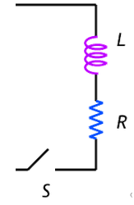




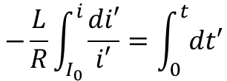





i
$I=$ $ℰ$/R
$$i\left(t=τ\right)=ℰ\text{/}\text{R}\text{(1−1/}\text{e}\text{) =0.63}ℰ\text{/}\text{R}$$
$$τ=L/R$$
t
What happens if we release energy stored in the solenoid
Kirchhoff’s loop rule:
$$ℰ −Ri−L\frac{di}{dt}=0$$
$$Ri+L\frac{di}{dt}=0$$
$$−\frac{L}{R}\int_{I_{0}}^{i}{\frac{di′}{i′}}=\int_{0}^{t}{dt′}$$
$$−\frac{L}{R}\ln{\frac{i\left(t\right)}{I_{0}}}=t$$
$$i=I_{0}e^{−\frac{R}{L}t}$$
i
$$I_{0}$$
I₀/e
$$τ=L/R$$
t

Slide 11
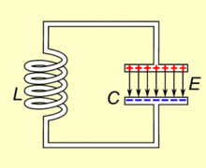



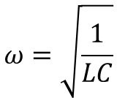
L-C circuits
L-C circuit shows qualitative new behavior
Because there is no power dissipation, energy once stored in C or L will periodically redistribute between energy in E-field and B-field
From http://en.wikipedia.org/wiki/LC_circuit
$$−\frac{q}{C}−L\frac{di}{dt}=0$$
$$−\frac{q}{C}−L\frac{d^{2}q}{dt^{2}}=0$$
Kirchhoff’s loop rule
$$\frac{d^{2}q}{dt^{2}}+\frac{1}{LC}q=0$$
$$ω=\sqrt{\frac{1}{LC}}$$
Compare with harmonic oscillator

