Slide 1
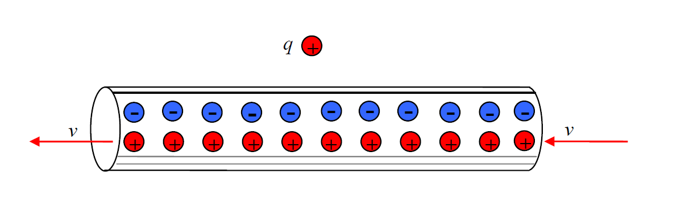
Sources of magnetic field
The magnetic field of a single moving charge
Our textbook starts by stating “experiments show that …”
-That is a valid point, always the supreme criterion, and historically what happened.
However, we have shown already in our relativistic consideration that moving charges of a current create a B-field.
Recall:
In the lab frame (frame of the wire) we interpret this as the magnetic Lorentz force
with
magnetic B-field in distance r from a wire carrying the current I

Slide 2
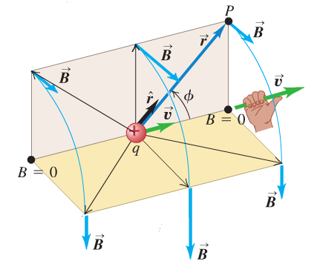
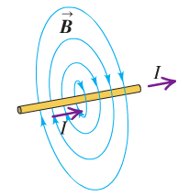
Next we show:
the field of the straight wire can be understood in terms of the sum of the contributions from individual moving charges
The field of a moving charge measured in P at r from the moving charge
reads
For an infinitesimal small charge dq we get
R
P
As we have shown
before in the
relativistic
consideration

Slide 3
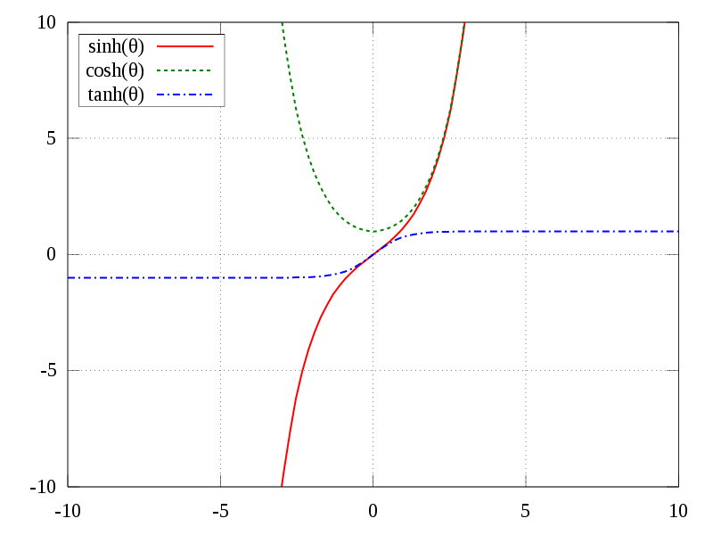
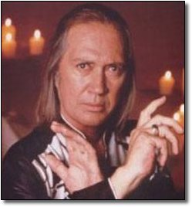
Auxiliary consideration (keep practicing):
With substitution sinh x= l/R
http://en.wikipedia.org/wiki/File:Sinh_cosh_tanh.svg
With

Slide 4
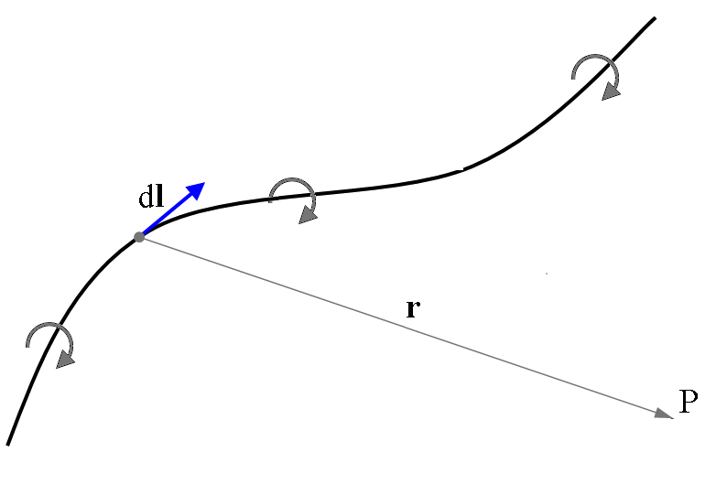
Biot-Savart law
The vector magnetic field expression for the infinitesimal current element
is known as law of Biot and Savart
It can be used to find the B-field at any point in space by and arbitrary current in a circuit
Biot and Savart law

Slide 5
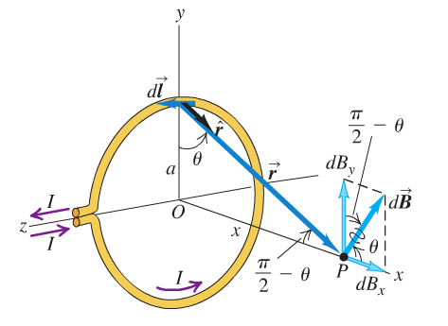
Let’s consider an important example
Magnetic field of a circular current loop at a distance x from the center
How do we know this is θ
Due to
Or you calculate for this particular element:
We take advantage of the symmetry to conclude:
The y-components of the B-field cancel out

Slide 6
with
and
For a thin coil of N loops we get for the magnetic field on the coil axis
and specifically at the center x=0
We can also express the field in terms of the recently introduced magnetic moment
Magnetic moment of N loops

Slide 7
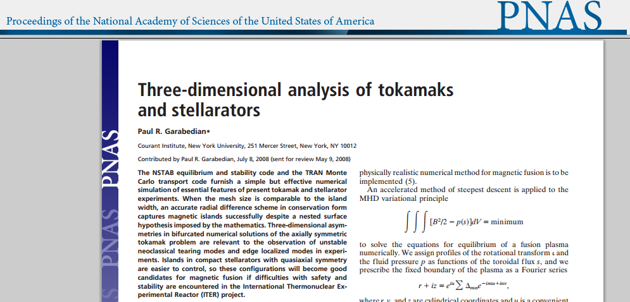
Application of Bio-Savat law for potential future fusion technology
See http://www.pnas.org/content/105/37/13716.full.pdf+html for complete article

Slide 8
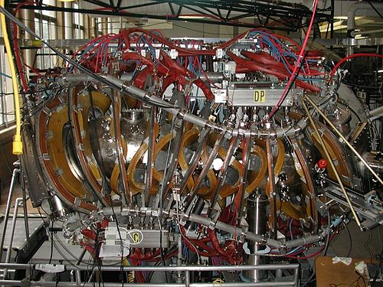
ITER (International Thermonuclear Experimental Reactor)
based on tokamak concept
HSX (Helically Symmetric eXperiment)
@Univ. of Wisconsin-Madison
Modular coil stellarator
https://www.iter.org/mach
Video from February 2014 on ITER
Latest News April 15, 2015

Slide 9
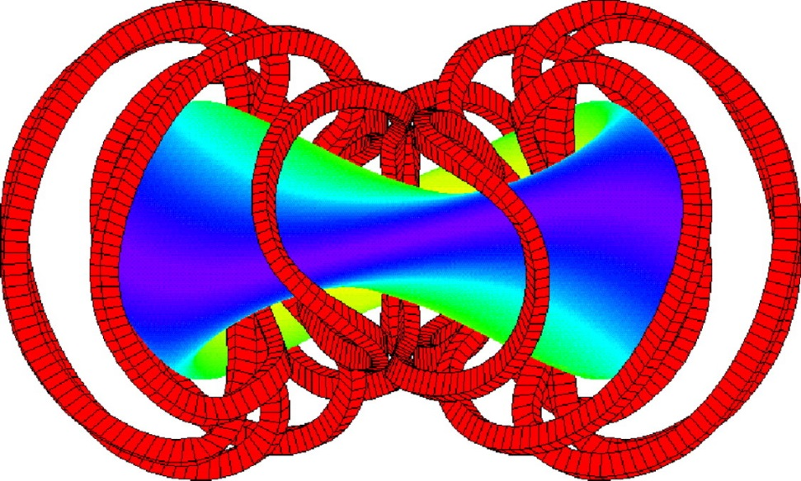
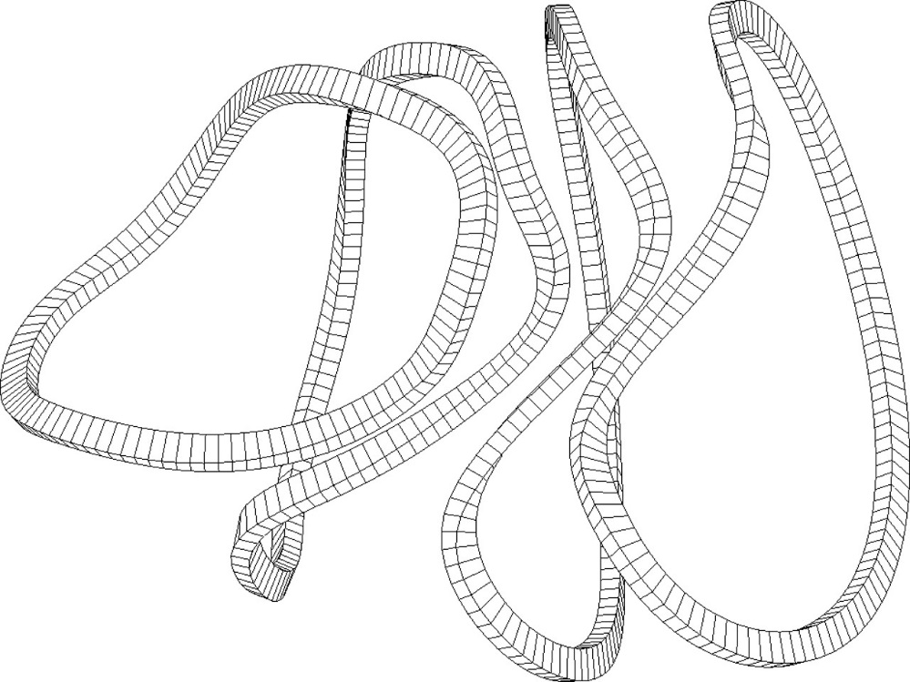
Diagram of the QAS2 stellarator
color map of the plasma surface
12 coils produce a magnetic field
designed to confine the plasma in equilibrium.
Garabedian P R PNAS 2008;105:13716-13719
Four of 12 modular coils that produce the magnetic field of the QAS2 stellarator
using the Biot–Savart law.

Slide 10
Ampere’s law
Similar to the simplified calculation of electric fields of charge distributions using Gauss’ law we can often find a simplified way to calculate magnetic fields of currents
Biot-Savart works always but integration can be tough
In electric case we could use Gauss’ law
Magnetic Gauss law
not so useful
Let’s explore what a line integral can do
In the electric case
because E conservative
What about

Slide 11
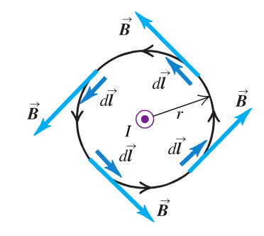

Let’s consider magnetic field caused by a long, straight conductor
We chose as integration path the path of the field line
Line integral just depends on the enclosed current (not on r… )
What if the integration path does not enclose the current ?

Slide 12
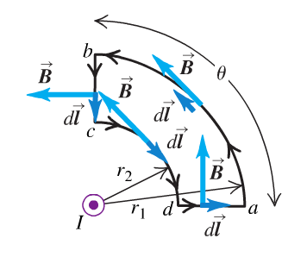
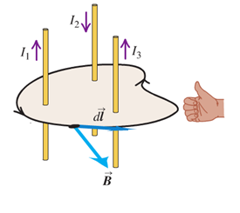
We consider this example (result holds in general see textbook)
a
b
b
c
d
d
a
c
a
b
c
d
Last step of generalization
What a positive or a negative current is with respect to the integration path is determined by the right hand rule
Curl fingers of right hand around
integration path
Arbitrary closed path around conductors
Thumb defines direction
of positive current

Slide 13
Ampere’s law
Remark: Often you find in the literature Ampere’s law written in term of the
H-field
magnetization
In vacuum the relation between B and H is simple
When fields in matter are considered situation is more complex
Let’s apply Ampere’s law (we use the B-field version for now)
Of course we could use it to determine the B-field of a long straight wire
Radial symmetry
of B-field is input

Slide 14
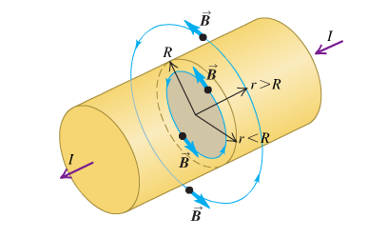
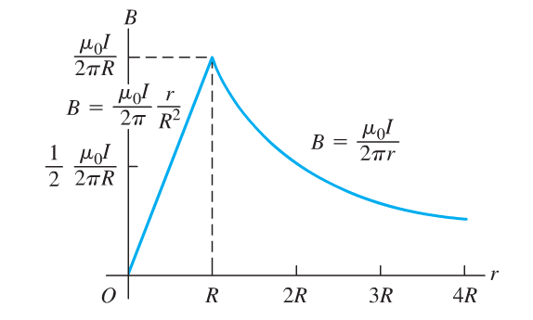
B-field inside a long straight wire

Slide 15
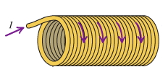
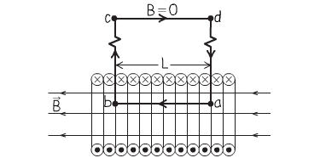
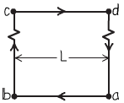
B-field of a long solenoid
Field is homogeneous
inside a central part
Let’s have a look to a central
part of the solenoid
a
b
with n=N/L number of turn per unit length

Slide 16
Clicker question
What can you say about the relation between the direction of the
B-field in the solenoid and the direction of the magnetic dipole moment?
There is no relation
2) They point in the same direction
3) They are antiparallel
4) They are orthogonal
5) They make angle of cos⁻¹B μ

