Slide 1
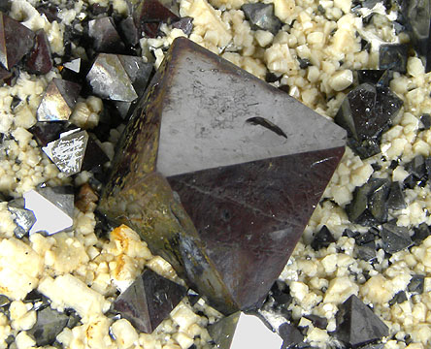
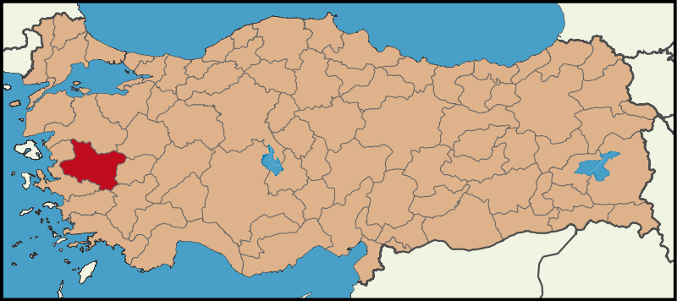
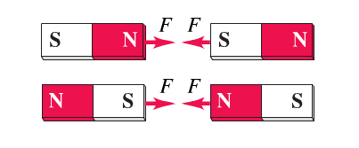
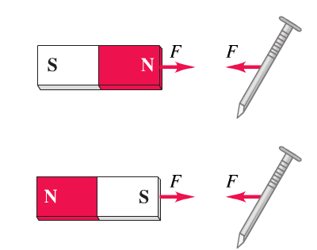
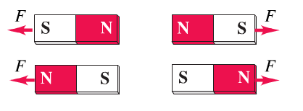
Magnetic field and forces
Early history of magnetism started with the discovery of the natural mineral magnetite
Named after the Asian province Magnesia
Octahedral crystal of magnetite,
an oxide mineral Fe₃O₄
Today’s Manisa in Turkey historically called Magnesia
Such crystals are what we today call permanent magnets and people found properties

Slide 2
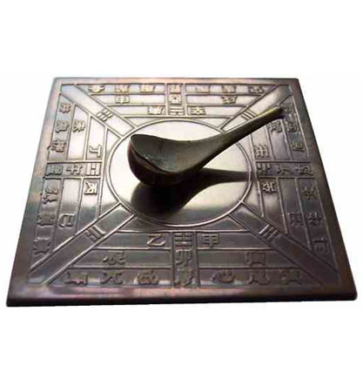
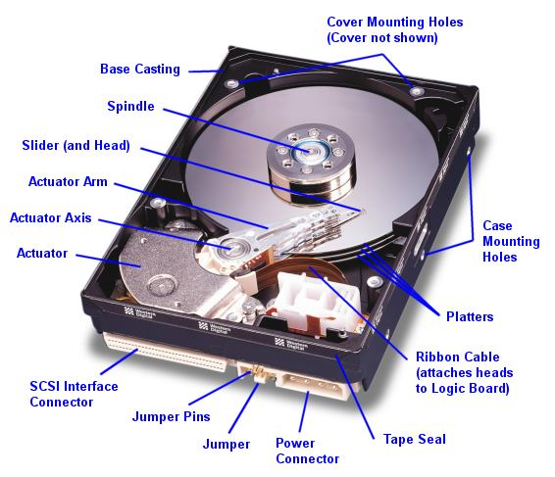
Modern HDD
Chinese compass
invented 2230 years ago
Instead of following the traditional (textbook) approach to first introduce the
phenomena we start by highlighting here the modern insight that
Electric forces and fields and magnetic forces and fields are unified through relativity
What led me more or less directly to the special theory of relativity was the conviction that the electromotive force acting on a body in motion in a magnetic field was nothing else but an electric field.
-Einstein 1953-
http://en.wikipedia.org/wiki/Relativistic_electromagnetism

Slide 3
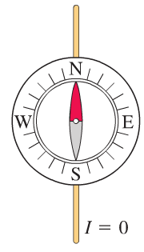
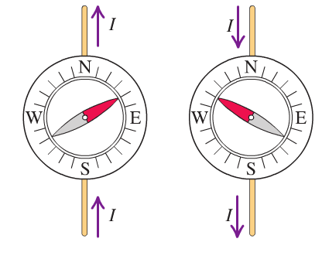
The origin of magnetic forces on a moving electric charge
A first hint at a fundamental connection between electricity and magnetism comes from Oersted’s experiment
Electric phenomenon Magnetic phenomenon
A distribution of electric charges
creates an E-field
A moving charge or a current creates (an additional) magnetic field
The E-field exerts a force F=q E on any other charge q
The magnetic field exerts a force F on any other moving charge or current

Slide 4
Where are the moving charges or currents in a permanent magnet?
We see later more clearly that these are the “moving electrons” on an atomic level (angular momentum L, spin S, J=L+S)
How can relativity show that a moving charge next to a current experiences a force
Let’s consider the special case that our test charge outside the wire moves likewise with v, the drift velocity of the electrons in the wire
drift velocity of
electrons, remember
Drude model of
conductivity
wire of
infinite length
charge density
Negative charge (electrons) flowing to the right
Stationary positive ions
Now we look at the situation from the perspective of the moving test charge q:
we transform into the moving coordinate system of the test charge

Slide 5
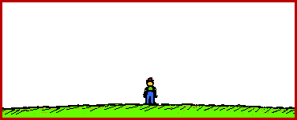
From the perspective (moving reference frame) of the test charge electrons are at rest and ions move
Now the “magic” of special relativity kicks in:
Spaceship moving with
10% of speed of light
Spaceship moving with
86.5% of speed of light
Lorentz-contraction quantified by
http://www.physicsclassroom.com/mmedia/specrel/lc.cfm

Slide 6
Due to Lorentz-contraction:
test charge sees modified charge density for moving + ions
test charge sees imbalance of charge
density for electrons and + ions
Since v-drift is about 0.1 mm/s <<c (see http://physics.unl.edu/~cbinek/Unit_13%20Current%20resistance%20and%20EMF.pptx) we can expand into Taylor series around x=v/c=0
Charge density of ions increased in the frame of the test charge

Slide 7
Likewise in comparison to lab frame (frame of the wire) the electrons are now seen at rest (were moving in the lab frame)
test charge sees charge density of electrons reduced by
(because test charge at rest sees wire as neutral despite moving negative charges)
Net effect: wire neutral in the lab frame gets charge density
in the frame of moving electron
Remember the electric field of an infinite wire with homogeneous charge density
Gaussian cylinder of radius r
l

Slide 8
For the moving charge in the moving frame we have
Moving charge sees an electric field
charge is exerted to a force away from the wire
In the lab frame (frame of the wire) we interpret this as the magnetic Lorentz force
with
magnetic B-field in distance r from a wire carrying the current I

Slide 9
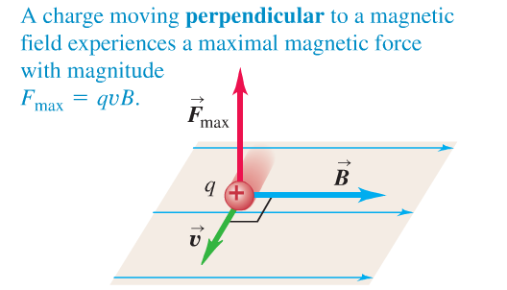
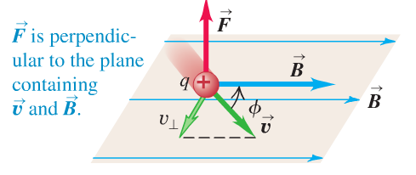
Our expression
holds for the special case
I
In general:
magnetic force on a moving charged particle

Slide 10
Clicker question
Considering the mathematical cross product structure of the Lorentz force.
Do you think that this magnetic force can do work on a charge?
1) Yes, it is a force and we can evaluate
2) No, the integral will always be zero
3) Yes, the integral will equal qvBl where l is the length of the path

Slide 11
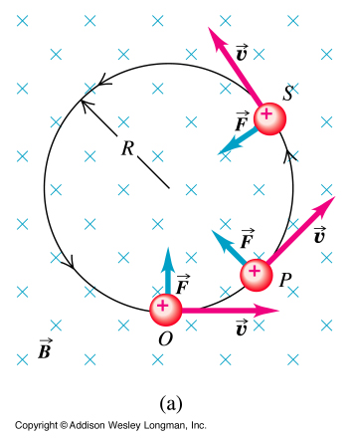
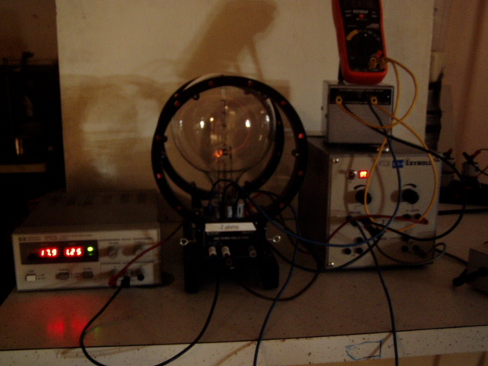
The e/m tube demonstration
We see Lorentz force F ⊥ v and hence ⊥ dr
no work
Circular orbit
v known from E_{kin}=qV_{ab}
With
$$\frac{q}{m}=\frac{v}{BR}$$
e/m= 1.76 x 10¹¹ C/kg
B known from current through Helmholtz coils
Cyclotron frequency
measure R vs. B
http://en.wikipedia.org/wiki/Cyclotron

Slide 12
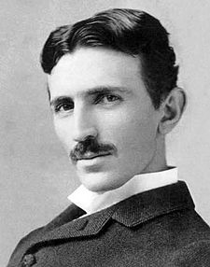
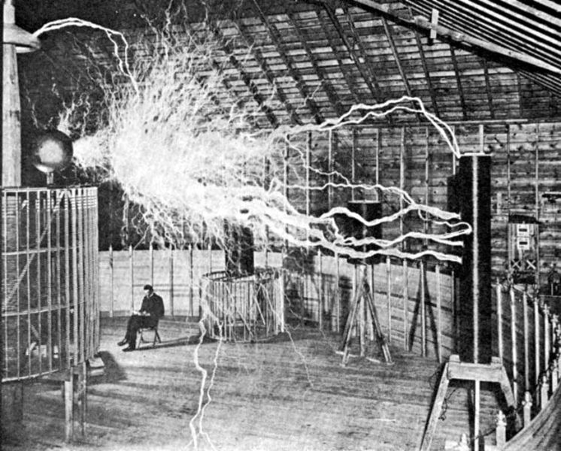
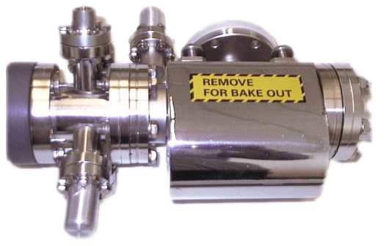
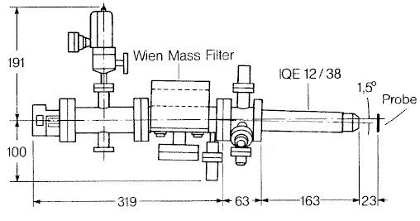
From
we can determine the unit of the B-field
in honor of Nikola Tesla
1T=1tesla=1N/Am
http://en.wikipedia.org/wiki/Nikola_Tesla
A moving charged particle in the presence of an E-field and B-field
It selects defined ions
by a combination of electric
and magnetic fields.
An application in modern research: the Wien mass filter
Resolution:
m/Δm > 20@5 keV
http://www.specs.de/cms/front_content.php?idart=148

Slide 13
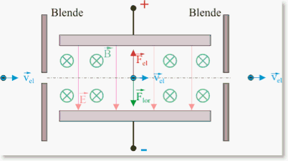
aperture
aperture
z
x
y
The charged particle will only follow a straight path through the crossed E and B fields, if net force acting on it is
zero
For the simple special case:
Wien filter can be used for mass selection if incoming particles have fixed kinetic energy

Slide 14
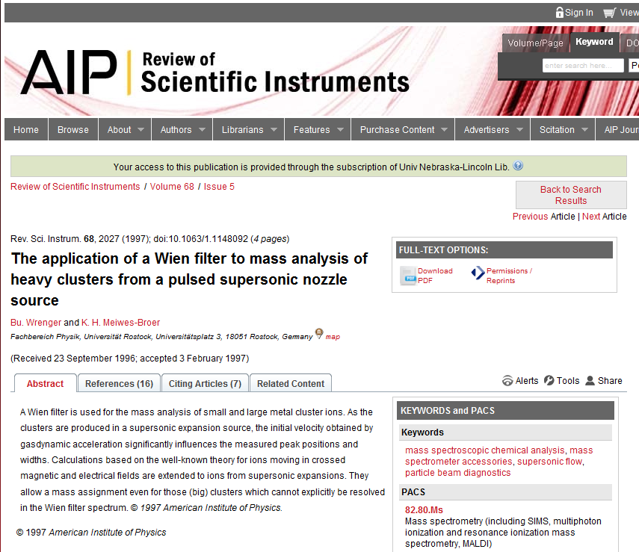
Is that the whole story of the Wien filter
Absolutely not, as this research manuscript from 1997 indicates

Slide 15
Equation of motion for particle of charge q and mass m in the filter:
viewer discretion is advised!
Do not click if you are not prepared
to see nastiness.
coupled differential equations, nasty!
But, we are honors students:
Not the goal but the game
Not the victory but the action
In the deed the glory

Slide 16
We define
introduced earlier already as cyclotron frequency
Back to
Solving first the homogeneous equation
Ansatz
Substitution into homogeneous differential equation
Solving the inhomogeneous equation
through
Solution of inhomogeneous equation is general solution of homogeneous
plus a particular solution of inhomogeneous
For the particular solution we try

Slide 17
With
is a solution
General solution of inhomogeneous differential equation
particular solution of
inhomogeneous differential eq.
general solution of
homogeneous differential eq.
With x(t=0)=0

Slide 18
Final adjustment of initial conditions:

Slide 19
Can we recover the simple case of acceleration free motion?
Motion is simple for
and
from
=0
=0
=0
motion with y(t)=0 for the entire path in the filter
This is of course the condition
aperture
aperture
z
No net force
x
y
In fact:
=0
=0

Slide 20
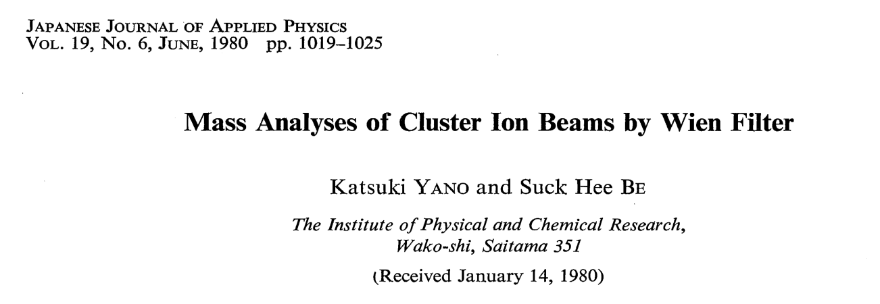
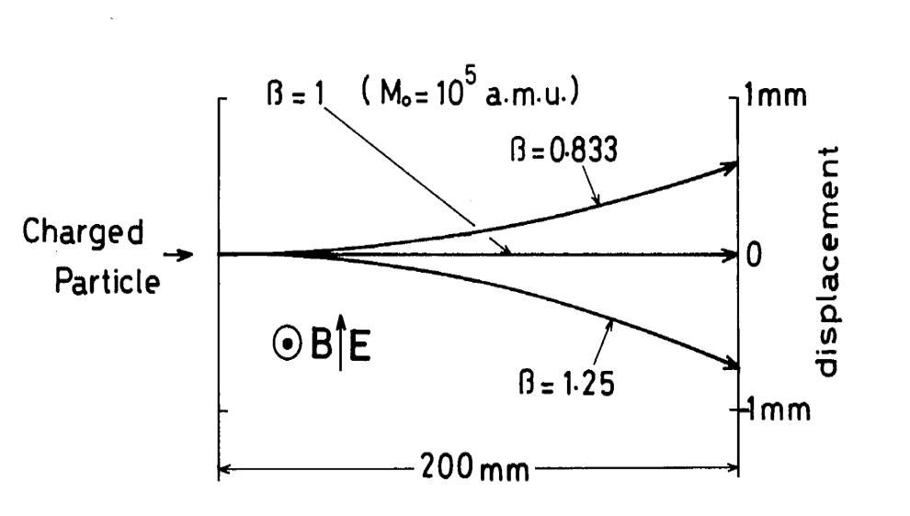
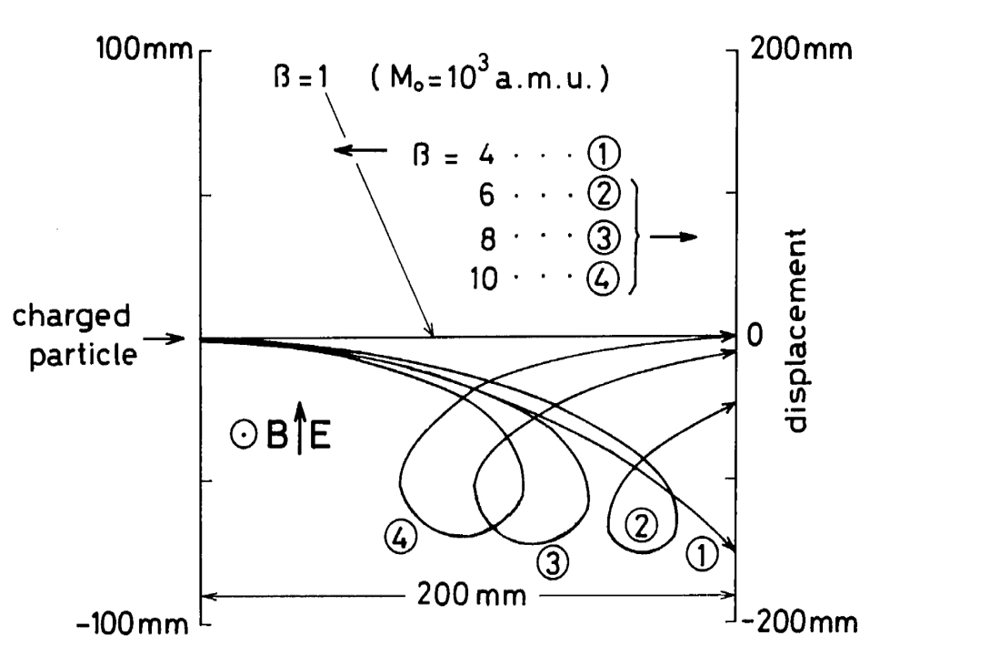
In general motion is very complex
Let’s consider charged particle with mass
M₀ moving with constant v through EXB
particle with mass M=M₀ /β has different initial v than particle with M₀
If β significantly deviates from 1
Trajectory deviates from straight line
trajectory can be very complicated and may spoil mass filter effect,
see trajectory for β=4

Slide 21
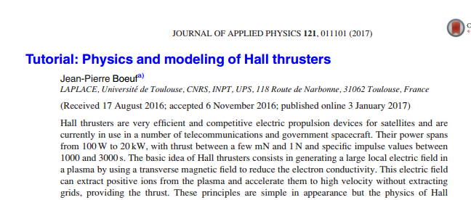
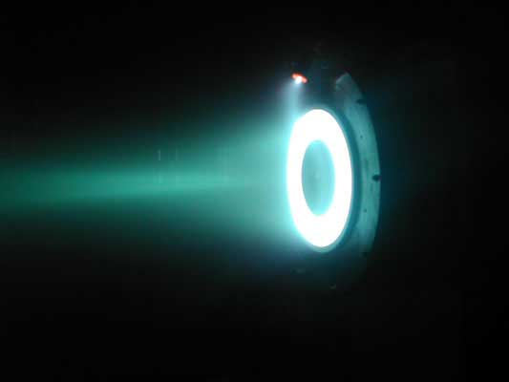
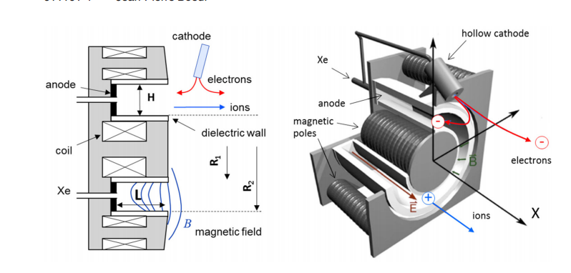
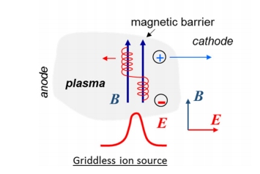
Other E x B devices
Common concept of plasma based cross-field devices:
A magnetic field traps electrons in a plasma giving rise to reduced electron conductivity and thus allowing for maintaining a large electric field in the plasma
Examples:
Hall-effect thruster: Ion thruster used in spacecraft propulsion
https://commons.wikimedia.org/wiki/File:HallThruster_2.jpg
Xenon ions are accelerated towards
cathode in the region of
reduced conductivity

Slide 22
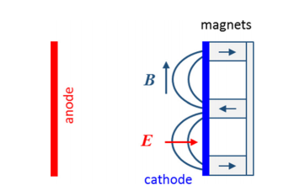
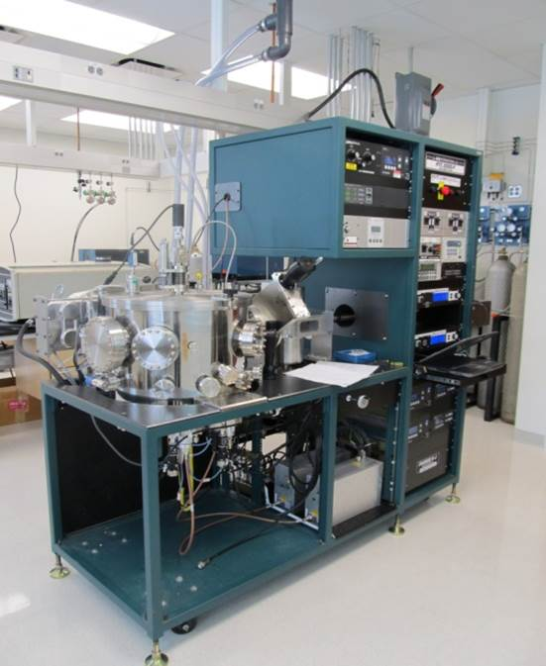
Example from material science:
Magnetron discharge: employed in magnetron sputtering for thin film deposition
Electrons generated at the cathode are trapped along the field lines until they undergo collision
Residence time of electrons in cathode region considerably
increased
Operation of discharge at low pressure possible because electron can ionize gas even though electron free path
larger than cathode-anode gap
http://ncmn.unl.edu/thinfilm/aja-sputtering-system

Slide 23
Physics of collisional electron transport in E x B
In a plasma, electrons can’t travel freely but collide with other particles at a rate $f=\frac{1}{τ}$
In steady state, momentum change from field forces and
momentum change from collision cancel
$\underline{F} τ+\frac{Δ\underline{P}}{τ}τ=0$
$\underline{F} +\frac{Δ\underline{P}}{τ}=0$
$q\left(\underline{E}+\underline{v}×\underline{B}\right)−\frac{m\underline{v}}{τ}=0$
$\frac{e_{0}}{m}\left(\underline{E}+\underline{v}×\underline{B}\right)+f\underline{v}=0$
$$\underline{v}×\underline{B}=\left|\begin{matrix}{\underline{e}}_{x} & {\underline{e}}_{y} & {\underline{e}}_{z} \\ v_{x} & v_{y} & v_{z} \\ 0 & B & 0\end{matrix}\right|=−v_{z}B{\underline{e}}_{x}+v_{x}B{\underline{e}}_{z}$$
With
$$\underline{E}=E{\underline{e}}_{x}$$
and
$$\underline{B}=B{\underline{e}}_{y}$$
$$\frac{e_{0}}{m}\left(E−v_{z}B \right)=−f v_{x}$$
$$\frac{e_{0}}{m}E−ω_{ce}v_{z}=\frac{f^{2}v_{z}}{ω_{ce}}$$
$$v_{z}=\frac{e_{0}}{m}E\frac{1}{ω_{ce}+\frac{f^{2}}{ω_{ce}}}$$
$$\frac{e_{0}}{m}v_{x}B=−f v_{z}$$
$$v_{x}=−f\frac{v_{z}}{ω_{ce}}$$
$$v_{x}=−\frac{e_{0}}{m}E\frac{f}{ω_{ce}^{2}+f^{2}}$$

Slide 24
For $ω_{ce}$≫f which means electron makes many orbits before it collides with another particle (given for the case of a Hall thruster)
$$v_{z}=\frac{e_{0}}{m}E\frac{1}{ω_{ce}+\frac{f^{2}}{ω_{ce}}}$$
$$v_{z}≈\frac{e_{0}}{m}\frac{E}{ω_{ce}}=\frac{E}{B}$$
$$v_{x}=−\frac{e_{0}}{m}E\frac{f}{ω_{ce}^{2}+f^{2}}$$
$$v_{x}≈−\frac{e_{0}}{m}E\frac{f}{ω_{ce}^{2}}=−\frac{e_{0}}{m}E\frac{fm}{ω_{ce}e_{0}B}=−\frac{E}{B}\frac{f}{ω_{ce}}$$
From this we see that the mobility of the electrons parallel to the electric field
$$μ_{e,E}=\frac{v_{x}}{E}=\frac{f}{Bω_{ce}}$$
is strongly reduced when compared to the case B=0
where
$$\frac{e_{0}}{m}\left(E−v_{z}B \right)=−f v_{x}$$
yields
$$\frac{e_{0}}{m}E=−f v_{x}$$
and thus
$$μ_{e,E}(B=0)=\frac{v_{x}}{E}=\frac{e_{0}}{m f}$$
In the absence of collisions electrons would be perfectly trapped

