Slide 2
Current, resistance and electromotive force
Current
Current is a concept with wide spread applications describing the rate of flow of some quantity that can be:
-Throughput of cars per time interval:
-water volume coming out of a hose per time interval:

Slide 3
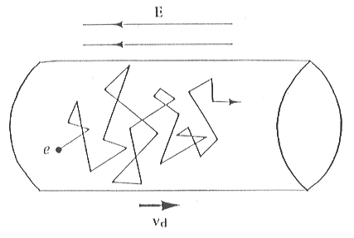
Electric current:
Motion of charge from one region to another quantified by
Currents in conducting materials:
Simple classical description (Drude model) to introduce basic relations
Almost random motion with average speed of 10⁶m/s
However, drift velocity in x-direction
very slow of the order of 10⁻⁴m/s
x
friction due to the scattering
processes
Classical equation of motion:
electric force F=qE
accelerating the charge q=-e₀
where v_{d} is the
drift velocity
superimposed to the random thermal velocity

Slide 4
Switching off the electric field
Relaxation to the thermal velocity within
relaxation time τ
Stationary state in an electric field:
0
dQ=q dN
dV=Adx
where

Slide 5
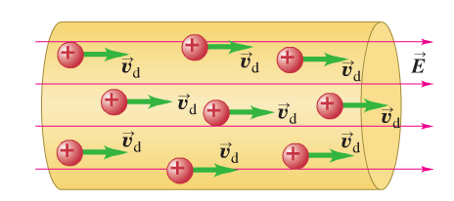
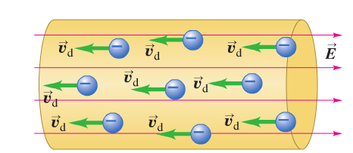
It is important to separate out which results are model dependent and which are general expressions
general expression for current density vector
Note: j is a vector, the current I is a scalar.
Note also, the orientation of j does not depend on the sign of the charge
Some remarks:
-direction of current flow
Conventional current
Positive charges in positive E-field
Experience force in positive x-direction
and define the positive current direction
Negative charges in positive E-field
experience force in negative x-direction
and produce likewise positive current

Slide 6
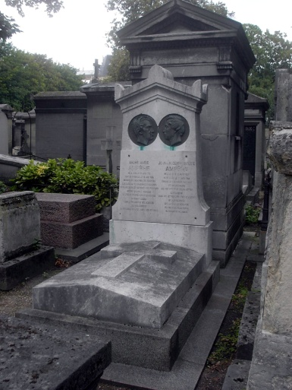
-The SI unit of current
1A=1 C/S
after André Marie Ampère
Resistivity
In our simple Drude model for metallic conductivity we found
with conductivity
a material dependent constant
The reciprocal of conductivity is resistivity
In general
if ρ is constant, meaning independent of E we call that Ohm’s law
after Georg Simon Ohm
Resistivity defined as

Slide 7
Note: in the most general case when materials are not isotropic, σ and ρ are
not scalars
Alternative formulation of “Ohm’s law”
V
A
Voltage drop V=E L
E
Current density:
I
We start from
L
and integrate current density over

Slide 8
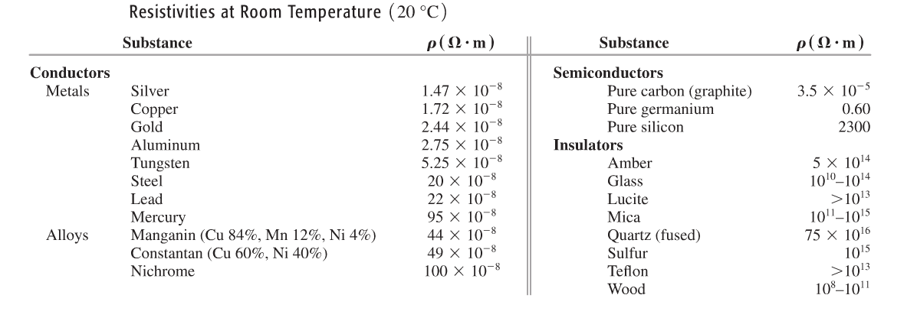
with
the resistance
Note: this equation is often called Ohm’s law. Again, Ohm’s law is the fact that R is in good approximation independent of V for metals.
Table from textbook Young & Freedman

Slide 9
Clicker question
Which of the following statements below is correct?
1) Ohm’s law is a fundamental law of nature
2) Ohm’s law is not a law in a strict sense but an approximation
which holds very well for metals
3) Ohm’s law is expressed by V=R I

Slide 10
Current-voltage relationship for
A resistor that obeys Ohm’s law
I
slope=1/R
V
A resistor with a nonohmic characteristic
such as a semiconductor diode
I
V

Slide 11
Resistivity and Temperature
ρ
T
Impurities: temperature independent imperfection scattering
phonon scattering
Scattering of electrons: deviations from a perfect periodic potential
Matthiessen’s rule:

Slide 12
In the linear regime we write
Table from textbook Young & Freedman
Simple approach to understand
for T>>Ө_{D}
Remember Drude expression:
scattering rate
scattering cross section
scattering cross section
Fermi velocity of electrons:
$$\left\langle u_{ω}^{2}\right\rangle =\frac{1}{2}{\left(u_{ω}^{0}\right)}^{2}∝T$$
#of scattering centers/volume

Slide 13
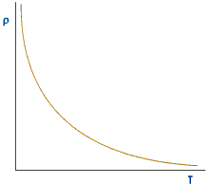
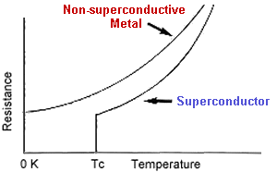
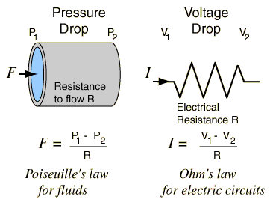
Note, temperature dependence of resistivity of non-metals can be very different
Typical semiconductor, e.g., Si
Superconductor
Flowing fluid analogy and interpretation of resistance
See also
http://hyperphysics.phy-astr.gsu.edu/hbase/electric/watcir2.html
In both cases
R∝ L
length of hose
length of wire
Also: R increases for narrow water hose
but the dependence is not 1/A

Slide 14
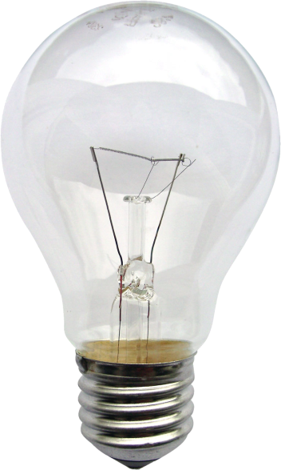
I_{wire}
I_{bulb}
100m of 12-gauge Cu wire
R_{wire}=0.5Ω
R_{bulb}=140Ω
@ operation T
Consider the situation I_{wire}=I_{bulb} but R_{wire}=0.5Ω and R_{bulb}=140Ω
Potential difference V=IR across light bulb >>V across wire
Each charge carrier loses more potential energy in the bulb
in comparison to the wire
This lost potential energy in the light bulb is converted into light and heat

Slide 15
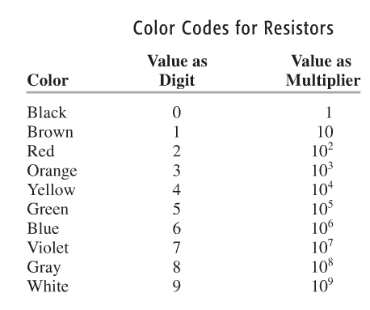
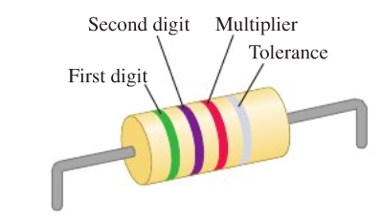
Color code for resistors and symbols in circuit diagrams
Example
R=
5
Ω=5.7kΩ ±10%
7
00
Table from textbook Young & Freedman
Symbols used in circuits
ideal conducting wire with R=0
resistor with non-zero resistance R

Slide 16
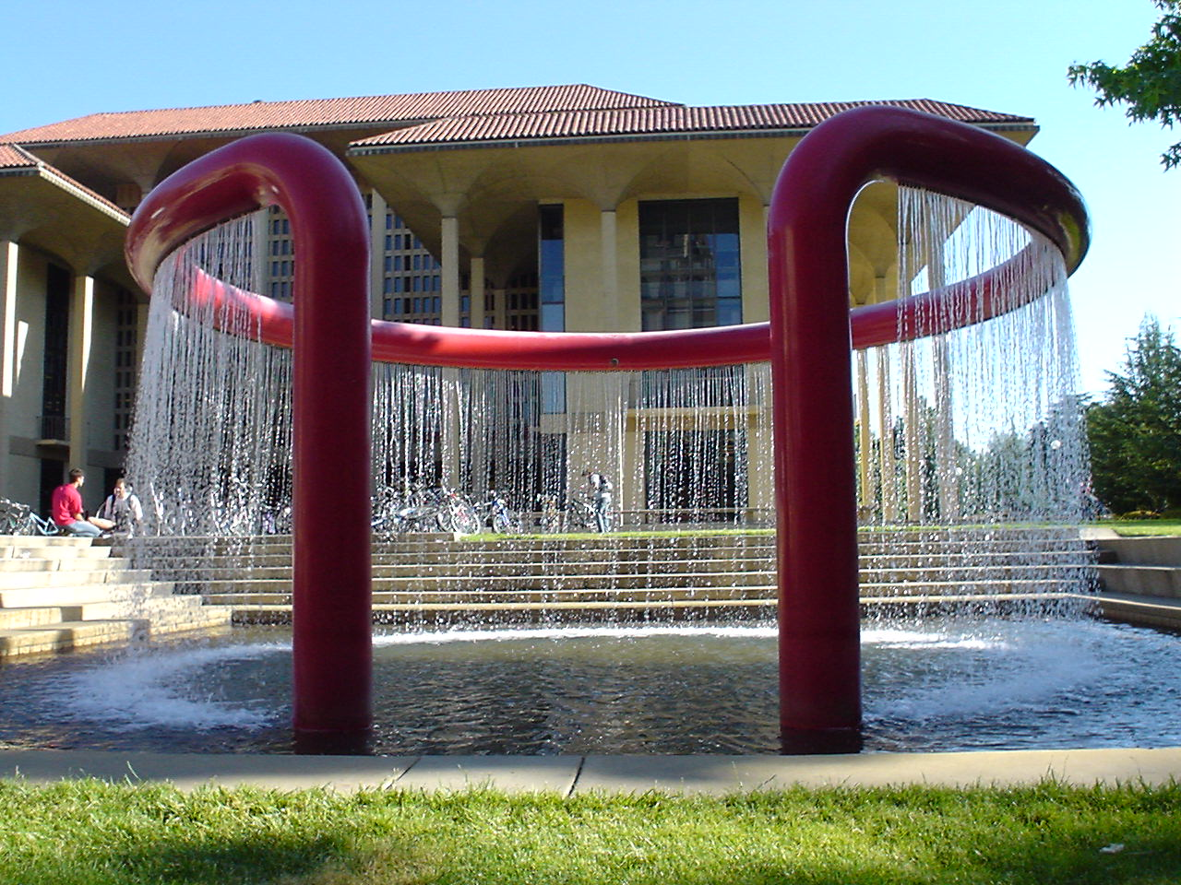
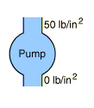
Electromotive force
Let’s consider the flowing fluid analogy again
High pressure
Pump increased
potential energy
of the water.
Water moves in the direction
of decreasing pot. Energy,
direction of gravitational force
Water intake
at low pressure
low pot. energy
In the pump water flows against
the gravitational force
Electric circuit
device similar to water pump where charge is moved “uphill”
from lower to higher potential energy.
What makes the electric current flow “uphill” is called electromotive force, emf

Slide 17
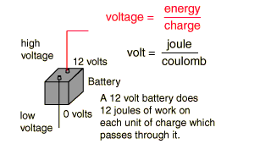
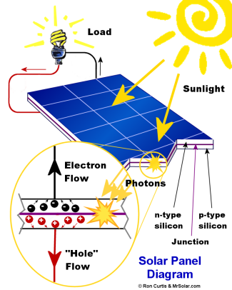
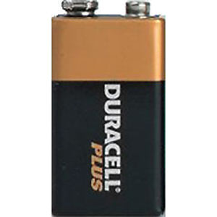
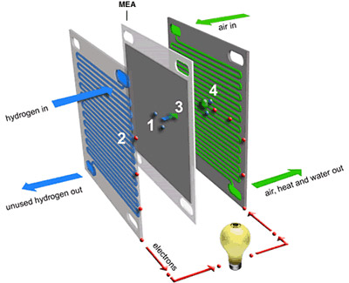
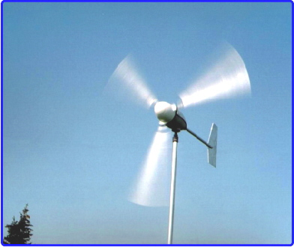
Every complete circuit with a steady current must include some device
that provides emf
Like the electric potential, emf (we use the variable ) is an energy per charge
If a battery has an emf of
battery does 12 J of work for every Coulomb
of charge passing through it to increase the
potential energy of the charge by 12J
Examples of sources of emf:

Slide 18
Let’s have a look at an ideal source of emf in the force picture
Terminal at higher
potential
V_{a}
+
nonelectrostatic
force moving the charge slowly from b to a
E
+
does work
V_{b}
Terminal
at lower potential
-
For an ideal source of emf

Slide 19
Let’s integrate the ideal source into a complete circuit
I
wire with non-zero
resistance R
E
V_{a}
Terminal at higher
potential
+
E
E
I
+
V_{b}
Terminal
at lower potential
-
E
I

Slide 20
Let’s integrate a real source into a complete circuit
Charge moving through real source
experiences resistance (a friction force)
V_{a}
Terminal at higher
potential
+
E
+
if internal resistance, r, ohmic
V_{b}
Terminal
at lower potential
-
Terminal voltage of a source with internal resistance

Slide 21
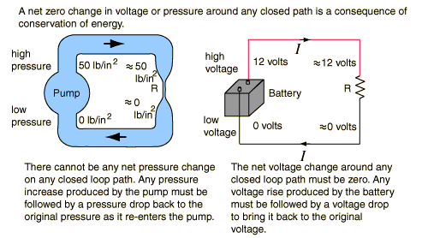
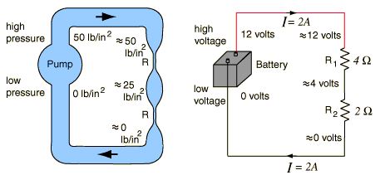
Potential changes around a circuit
We know: net potential energy change for a charge making a round trip is zero
We can express this by rearranging
into
The sum of all potential drops and emfs around a loop is zero
http://hyperphysics.phy-astr.gsu.edu/hbase/electric/watcir2.html#c2

Slide 22
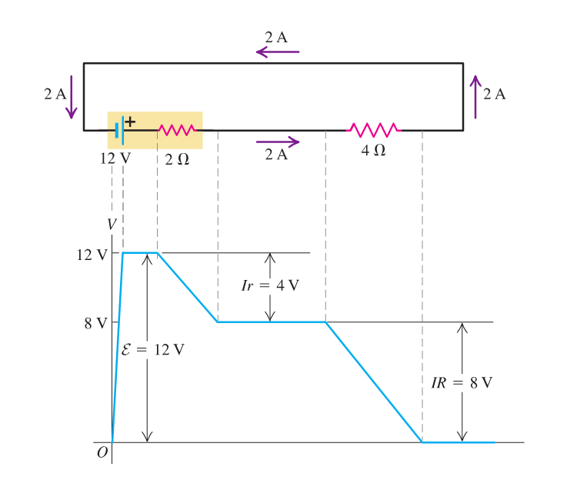
An example for
for a circuit with a real source
From textbook Young & Freedman

