Slide 1
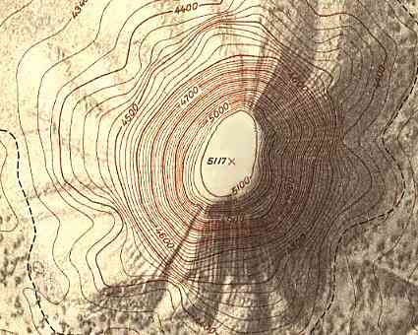
Equipotential surfaces and field lines
Equipotential surfaces
Equipotential surfaces are mathematically speaking hypersurfaces
The potential in Cartesian coordinates is a function V=V(x,y,z)
With V(x,y,z)=const we define a 2D surface z=z(x,y) in 3D space
We can better picture the situation in 2D
Example: contour lines in toporaphic maps

Slide 2
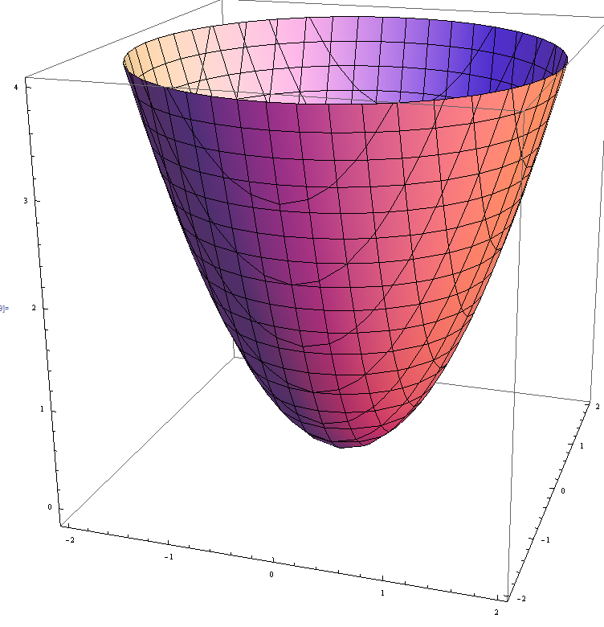
z
2D surface in 3D space
Contour line
1D equi-value “surface”
y
x
Note that one could consider
as equi-value surface of

Slide 3
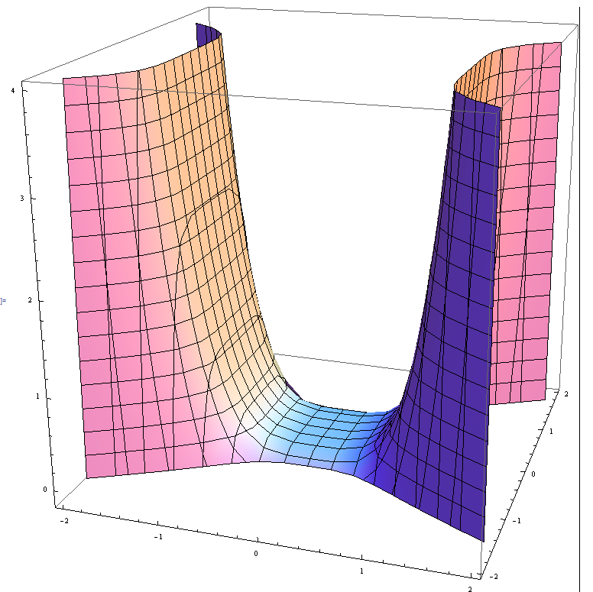
Some properties of equipotential surfaces
-in general an equipotential surface is a hypersurface defined by V(x,y,z)=const
-per definition V is the same everywhere on the surface
If you move a test charge q₀ on this surface the potential energy U= q₀V
remains constant
no work done
if E-field does no work along path of test charge on surface
E-field normal surface
E
It is a general property of the gradient of a function that
dr
*
Simple 2D example for this general property
*click here for
proof

Slide 4
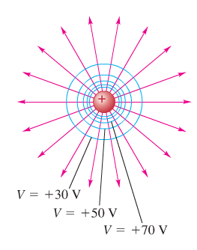
-no point can be at different potentials
equipotential surfaces never touch
or intersect
-field lines and equipotential surfaces are always perpendicular
Examples from our textbook Young and Freedman University Physics page 799
point charge
E-field lines
Cross sections of equipotential surfaces
How do we get the circle solution ?
Remember
Similar to higher field line density indicating stronger E-field
Higher density of equipotential contour lines indicates a given change in the potential takes place with less distance
visualization of stronger E-field because

Slide 5
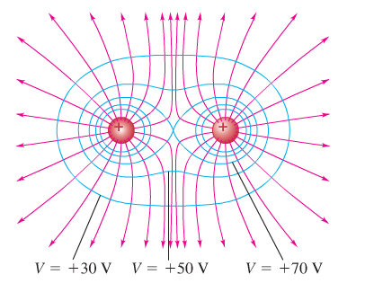
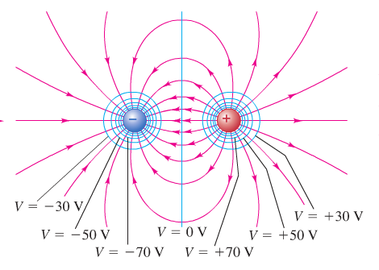
Electric dipole
2 equal positive charges
Note, the electric field is in general not the same for points on an equipotential surface

Slide 7
Equipotentials and Conductors
When all charges are at rest, the surface of a conductor is always an equipotential surface.
Proof:
We use the facts that
the E-field is always perpendicular to an equipotential surface
E=0 inside a conductor
We use ii) to show that (when all charges at rest) the E-field outside a conductor must be perpendicular to the surface at every point
With i) that implies that surface of a conductor is equipotential surface
E=0 inside a conductor because otherwise charges would move
E tangent to surface inside conductor zero
E tangent to surface (E||) outside conductor zero
E||=0 just outside the
conductor surface to ensure
Since E||=0 inside conductor
Remember E is conservative and work along closed path must be zero

Slide 8
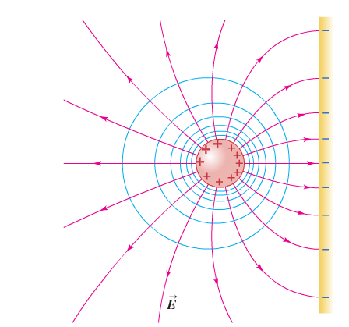
in the absence of any tangential component, E||,
E can only be perpendicular to the conducting surface
Conductor
Surface of a conductor

