Slide 1
Electricity & Magnetism
Electrostatics
Introductory remarks
Electricity deals with phenomena outside the realm of mechanics (Phys211)
new concepts and terminology is required*
*Note, it is the beauty of physics to realize how the new concepts and those known
from mechanics merge into a unified bigger picture
Among those new electric quantities and a good starting point for our
investigation is the
Electric charge

Slide 2
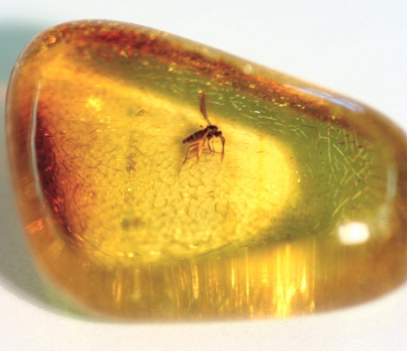
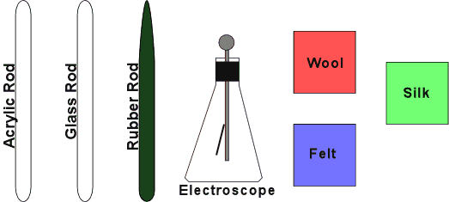
Electric charge
Greek word elektron =amber
electric
Where is the connection between amber and electricity
The Greek discovered 600 B.C.
Rubbing amber against fur of a cat, dead or alive
Note, if you repeat the experiment, do not kill a cat, a plastic fur works just fine!
Today we say: amber has acquired a net electric charge
Let’s do similar experiments and draw some conclusions

Slide 3
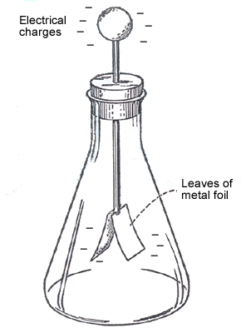
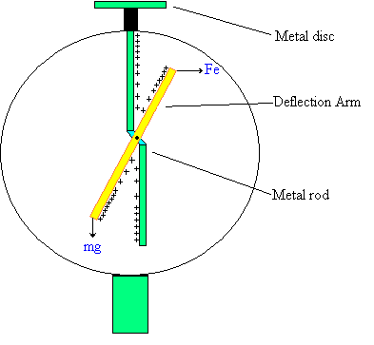
Our experiments and numerous others show
The harmonic approximation
There are exactly 2 kinds of charge. According to Benjamin Franklin we call
them positive and negative charge
Two positive charges or two negative charges repel each other
A positive charge and a negative charge attract each other
The electroscope is a device that allows to determine the amount of charge

Slide 4
Clicker question
When two identical socks are removed
from a clothes dryer, they will usually
1) repel each other
2) cling to each other
3) no way to predict

Slide 5
Clicker question
Do you have access to MasteringPhysics
A) Yes
B) No
C) No, but I am confident
to get it from by Thursday

Slide 6
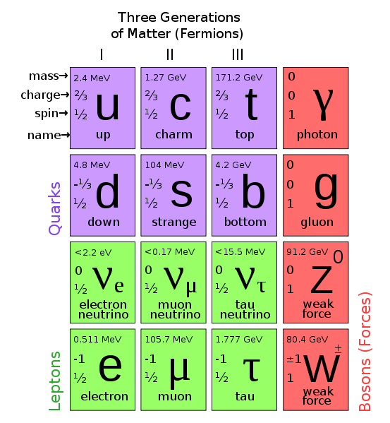
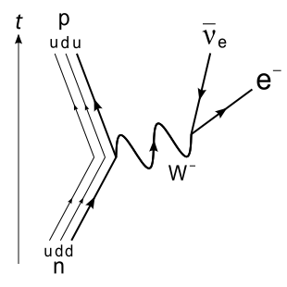
Electric charge and the structure of matter
The standard model of elementary particles
Electricity, atomic forces, binding,
optics, …
Quark binding in nuclear particles
Radioactive β-decay
(Weak nuclear)
http://en.wikipedia.org/wiki/File:Standard_Model_of_Elementary_Particles.svg
Note, gravity not included in this scheme

Slide 7
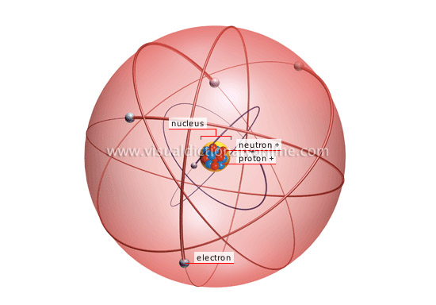
Positively charged protons and neutral neutrons build nucleus
Neutral atom
Nucleus
Nucleus with n protons
surrounded by same # n
of electrons with negative charge
≈10⁻¹⁵m
≈10⁻¹⁰m
Note, figure very misleading regarding size ratio !
If an atom were a few km across, its nucleus would be the size of a tennis ball!
If# of protons ≠ # of electrons
ion

Slide 8
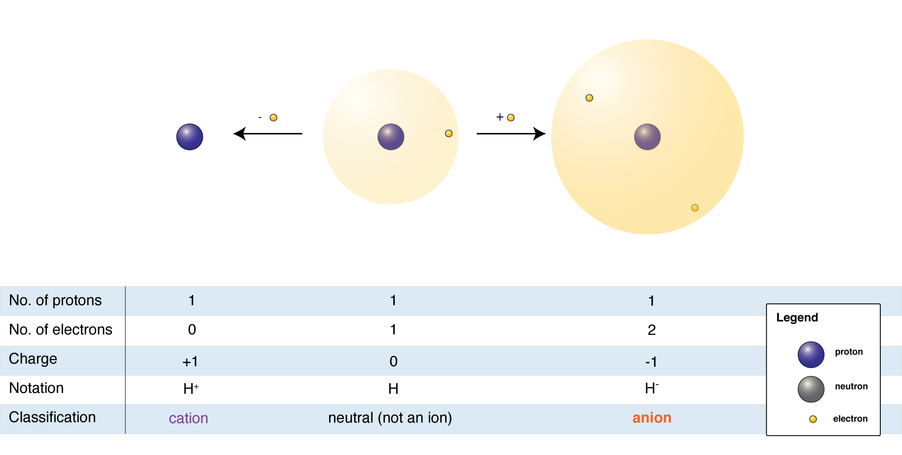
Let’s consider the simple example H, H⁺, H⁻
+|e|-|e|=0 neutral
Hydrogen (H) atom
Proton with
charge +|e|
H⁻=H+ extra electron
- charged ion=anion
H⁺=proton remains
+ charged ion=cation
Electron with
charge -|e|
Remove
electron
add
electron

Slide 9
Our experimental observations suggest:
Electric charge is conserved
Charge is not created or destroyed it can only be transferred from one body to another.
Q_{in}
Q(t₂)=
Q(t₁)+Q_{in}-Q_{out}
Q_{out}
Charge Q
at time t₁
The magnitude of charge of the electron or proton is a natural unit of charge
Every observable amount of charge is always a multiple of this unit.
Final remark:
Conservation laws in physics have always a fundamental and deep meaning
In general: Conservation laws are the consequence of a symmetry (Noether theorem)
Charge conservation follows from gauge invariance (way beyond the scope of this course)

Slide 10
Clicker question
Do we want to meet tomorrow for a recitation
A) Yes, I pay a lot of tuition and want to
get the most out of my investment.
B) No, there is not much of a point,
we have not covered enough material and I can spend my time more
productive.
C) Let’s meet, it is just fun to hang out with Dr. Binek.

