Slide 1
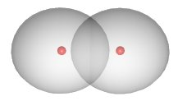
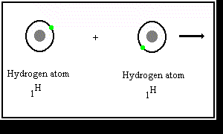
Covalent Bond
= (valence or homopolar bond)
2 atoms share electrons (two electrons=single bond) to equal amounts
no polarity
H₂-molecule most simple example

Slide 2
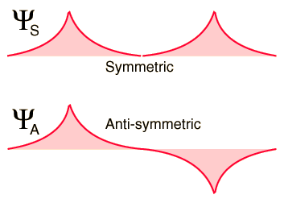
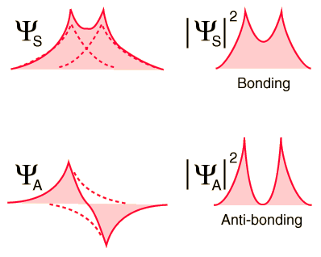
More detailed picture: Overlap of 1s electron orbitals of H-atoms
Molecular orbitals
Click for coupled pendula analogy

Slide 3
Why is there no covalent bond for two He atoms
Again we start from the molecular orbitals (MO) described by symmetric
and antisymmetric superposition of 1s-wavefunctions
anti-binding
σ*-MO
Energy
1s (He atom A)
binding
1s (He atom B)
σ-MO
Reduction of energy by filling the σ-MO with 2 electrons
compensated by energy required to fill σ*-MO
anti-binding
covalent He-He bond
energetically not favorable
Energy
σ*-MO
but
1s (He atom A)
binding
1s (He atom B)
He₂⁺ stable molecule
σ-MO

Slide 4
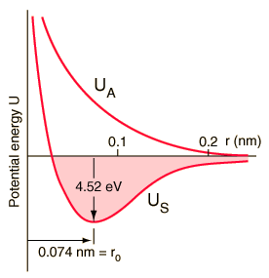
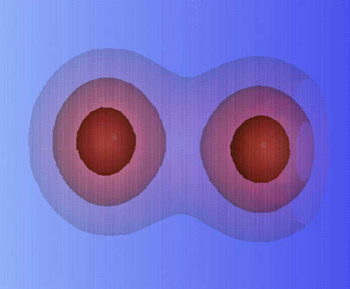
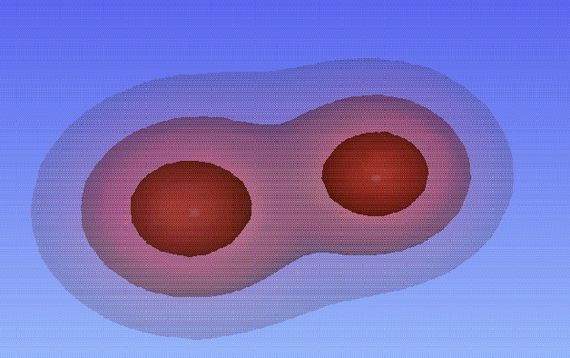
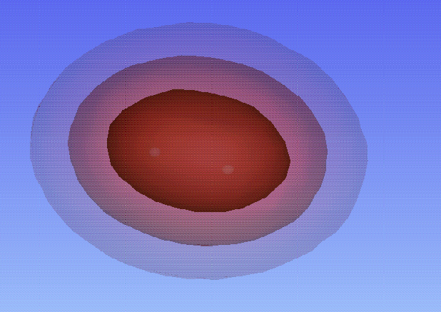
Idea of the quantitative approach
QM-problem to solve:
unperturbed H-atom 1:
unperturbed H-atom 2:
Interaction on approaching the atom2 to atom 1:

Slide 5
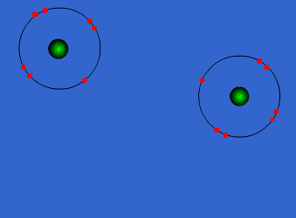
Covalent Bond in Cl₂
Electronic configuration of Cl
Electronic configuration
of N
3-fold Covalent Bond in N₂

