Slide 1
Interatomic Binding
Click here for a link to CERN
Celestial mechanics,
Structure of the universe
Atomic forces, binding,
Optics, electricity,...
Radioactive β-decay
Quark binding in nuclear particles
Binding between atoms derives from electrical attraction and repulsion

Slide 2
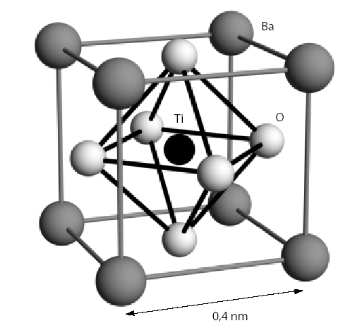
total (free) energy of the solid < sum of (free) energy of its individual, separated atoms
binding
solid
free
energy
temperature change can change the structure
Click for information regarding thermodynamic potentials
Example: BaTiO₃

Slide 3
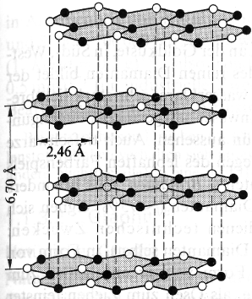
Van der Waals bond
Weak interaction 0.2 eV/atom
, always present
solid inert gases*
*except He remaining liquid at normal pressure down to T->0
due to qm zero point fluctuations
but
typically Van der Waals interaction masked by stronger interactions
strong covalent bonding
Graphite
Van der Waals bond
Solid lubricant

Slide 4
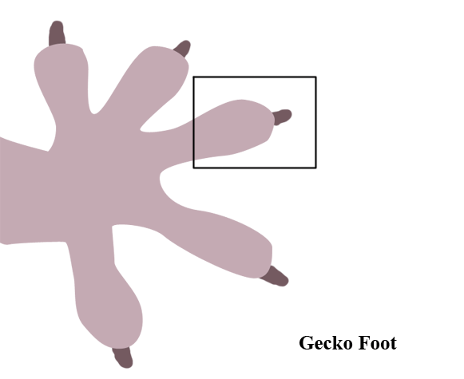
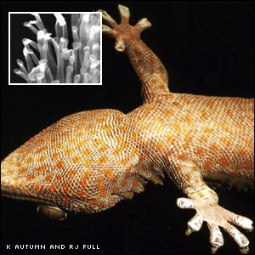
Spatulae of gecko feet are small and get so close to the surface that an attractive van der Waals force of around 0.4 µN develops between a single spatula and a surface.
Combined force of the millions of spatulae on a single gecko foot produce an adhesion force of around 10 N, or around 2.25 lbs.
Animation from: http://mota.stanford.edu/education/Physics%2087N%20Final%20Projects/Group%20Gamma/gecko.htm#_edn4

Slide 5
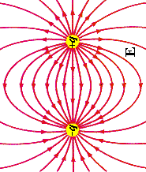
Snapshot at t=t’
+
+
d
p
+
-
+
for
Interaction energy:

Slide 6
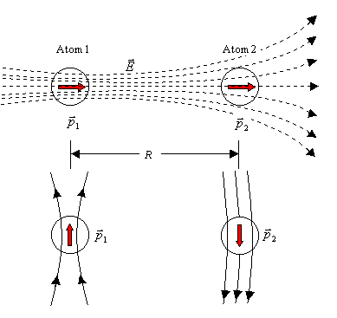

Slide 7
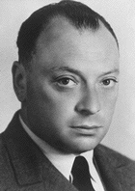
Repulsive contribution due to Pauli exclusion principle
Pauli exclusion principle:
Two electrons (identical fermions) can't be in the same quantum state
or
Wolfgang Pauli
total wave function of the many electron system has to be antisymmetric
Click for more information
Electron has to leave the ground state
Energy increase
Repulsive interaction

