Slide 1
in integral form
Maxwell’s Equations
Gauss’s Law
Gauss’s Law for Magnetism
Faraday’s Law
Ampere’s Law
Notes:
dS = n dA
Flux = field integrated over a surface
No magnetiic monopoles
E .dl is an EMF (volts)

Slide 2
Maxwell’s Equation’s in free space (no charge or current)
Gauss’s Law
Gauss’s Law for Magnetism
Faraday’s Law
Ampere’s Law
Notes:
dS = n dA
Flux = field integrated over a surface
No magnetiic monopoles
E .dl is an EMF (volts)

Slide 3
Hertz’s Experiment
An induction coil is connected to a transmitter
The transmitter consists of two spherical electrodes separated by a narrow gap
The discharge between the electrodes exhibits an oscillatory behavior at a very high frequency
Sparks were induced across the gap of the receiving electrodes when the frequency of the receiver was adjusted to match that of the transmitter
In a series of other experiments, Hertz also showed that the radiation generated by this equipment exhibited wave properties
Interference, diffraction, reflection, refraction and polarization
He also measured the speed of the radiation
Check out also this link on Hertz’s wireless experiment

Slide 4
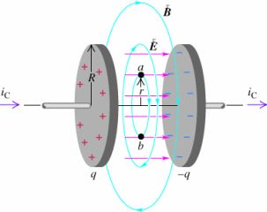
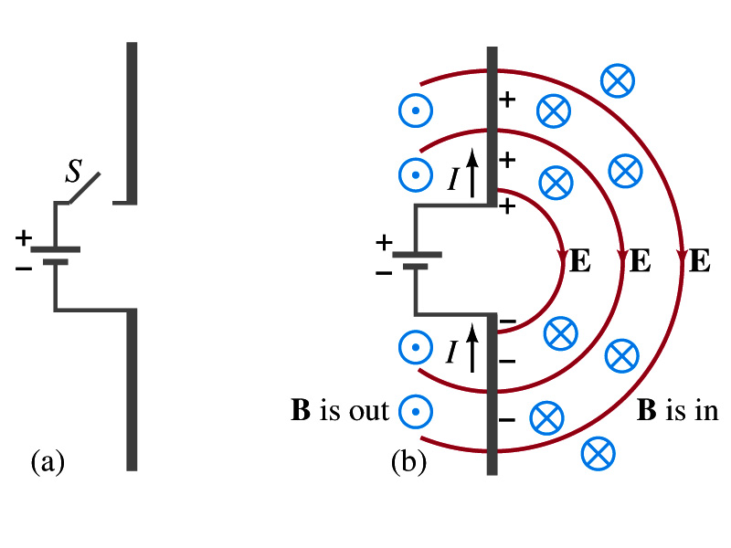
Implication
A magnetic field will be produced in empty space if there is a changing electric field.
(correction to Ampere’s law)
This magnetic field will be changing. (initially there was none!)
The changing magnetic field will produce a changing electric field. (Faraday)
This changing electric field
produces a new changing magnetic field.

Slide 5
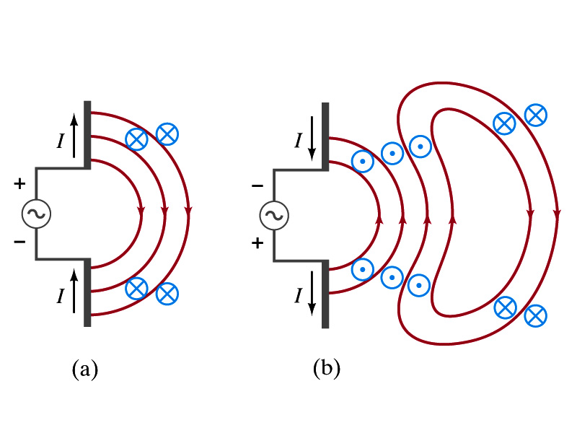
An antenna
Hook up an
AC source
We have changed the magnetic field near the antenna
An electric field results! This is the start of a “radiation field.”

Slide 6
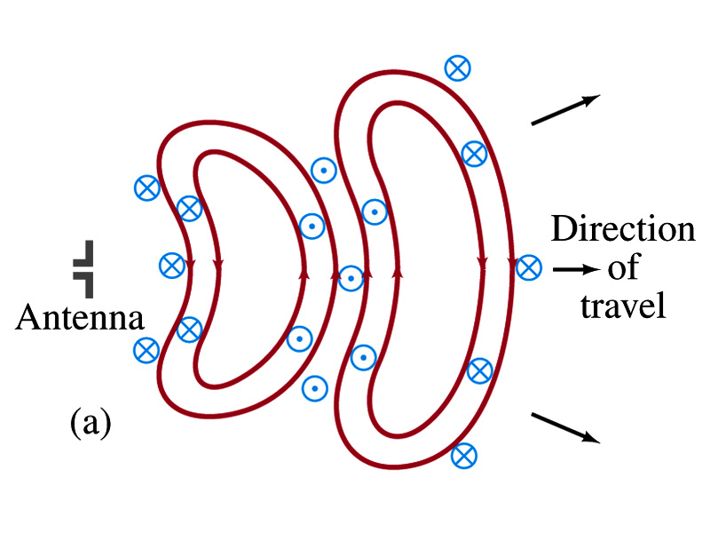
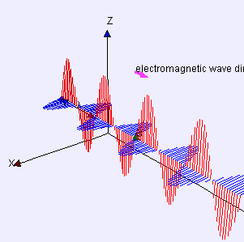
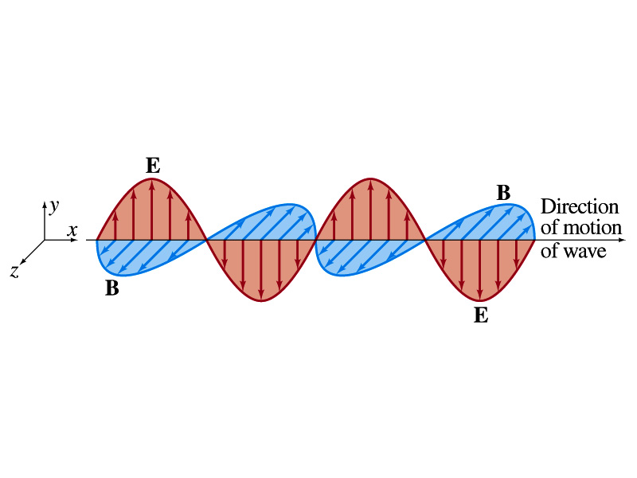
Look at the cross section
Called:
“Electromagnetic Waves”
Accelerating electric charges give rise to electromagnetic waves
E and B are perpendicular (transverse)
We say that the waves are “polarized.”
E and B are in phase (peaks and zeros align)
"Electromagneticwave3D" by Lookang many thanks
to Fu-Kwun Hwang and author of Easy Java Simulation
= Francisco Esquembre - Own work. Licensed under
CC BY-SA 3.0 via Wikimedia Commons - http://commons.wikimedia.org/wiki/File:Electromagneticwave3D.gif#/media/File:Electromagneticwave3D.gif

Slide 7
Angular Dependence of Intensity
This shows the angular dependence of the radiation intensity produced by a dipole antenna
The intensity and power radiated are a maximum in a plane that is perpendicular to the antenna and passing through its midpoint
The intensity varies as
(sin² θ) / r²

Slide 8
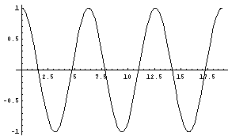
Harmonic Plane Waves
At t = 0
λ = spatial period or
wavelength
x
λ
At x = 0
t
Τ = temporal period
Τ

Slide 9
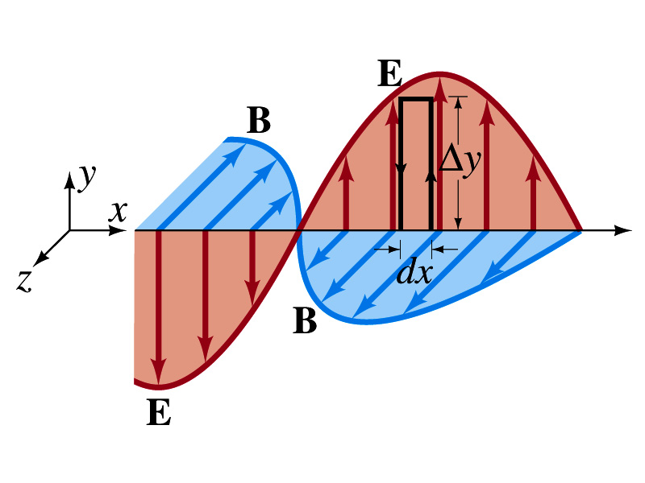
Applying Faraday to radiation

Slide 10
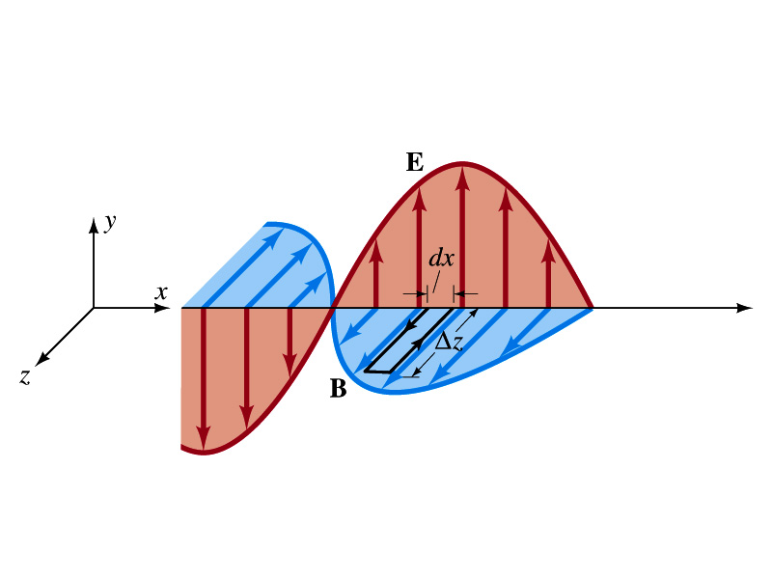
Applying Ampere to radiation

Slide 11
Fields are functions of both position (x) and time (t)
$$\left|{}_{}^{}{\frac{∂}{∂x}}\right.$$
Partial derivatives are appropriate
$$\left|{}_{}^{}{\frac{∂}{∂t}}\right.$$
This is a wave equation!

Slide 12
The Trial Solution
The simplest solution to the partial differential equations is a sinusoidal wave:
E = E_{max} sin (kx – ωt)
B = B_{max} sin (kx – ωt)
The angular wave number is k = 2π/λ
λ is the wavelength
The angular frequency is ω = 2πƒ
ƒ is the wave frequency

Slide 13
The trial solution

Slide 14
The speed of light (or any other electromagnetic radiation)

Slide 15
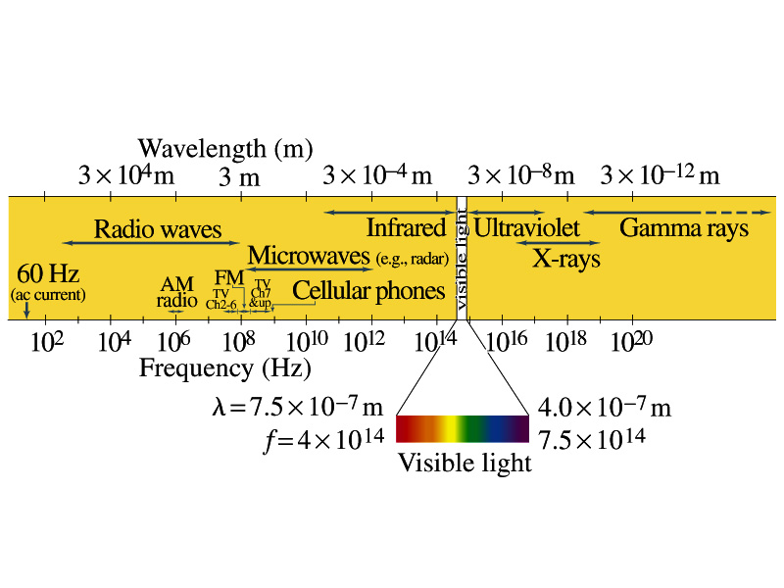
The electromagnetic spectrum

Slide 16
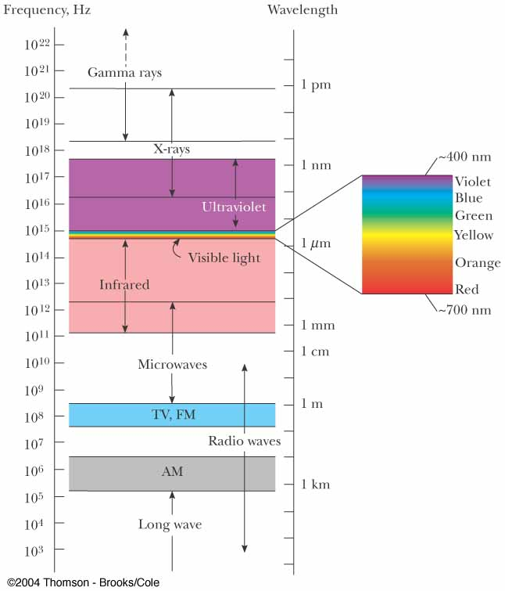

Slide 17
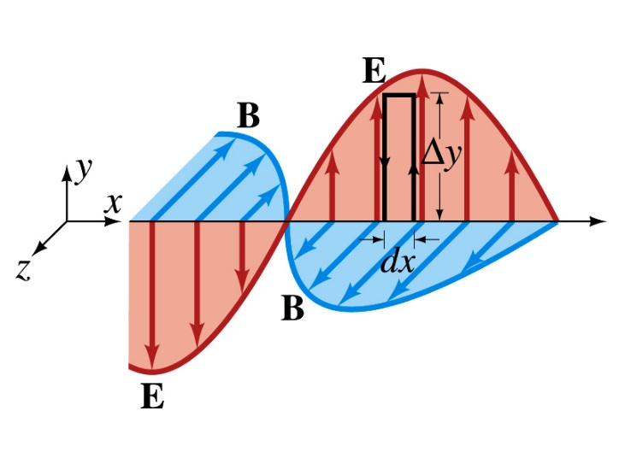
Another look

Slide 18
Energy in Waves

Slide 19
Poynting Vector
Poynting vector points in the direction the wave moves
Poynting vector gives the energy passing through a unit area in 1 sec.
Units are Watts/m²

Slide 20
Intensity
The wave intensity, I, is the time average of S (the Poynting vector) over one or more cycles
When the average is taken, the time average of cos²(kx - ωt) = ½ is involved

Slide 21
Radiation Pressure
(Absorption of radiation
by an object)
Maxwell showed:
What if the radiation reflects off an object?

Slide 22
Pressure and Momentum
For a perfectly reflecting surface,
Δ p = 2U/c and P = 2S/c
For a surface with a reflectivity somewhere between a perfect reflector and a perfect absorber, the momentum delivered to the surface will be somewhere in between U/c and 2U/c
For direct sunlight, the radiation pressure is about 5 x 10⁻⁶ N/m²

Slide 23
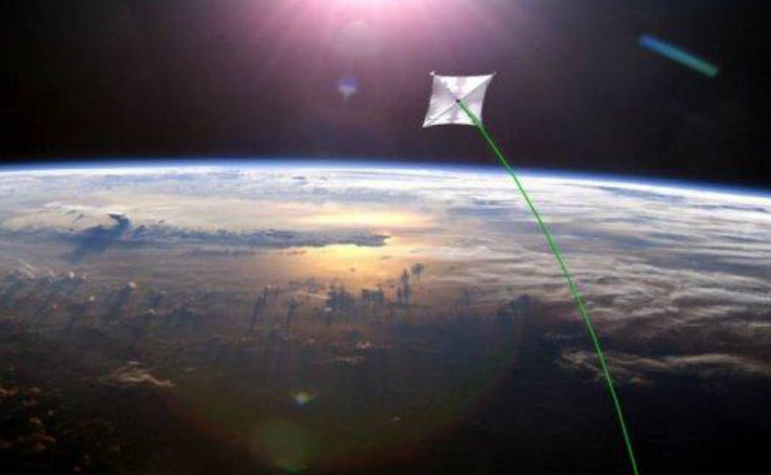
A Roadmap to Interstellar Flight
We follow proposal by Philip Lubin and others https://www.nasa.gov/multimedia/podcasting/nasa360/index.html
Concept:
Leave main propulsion system in Earth orbit (photon driver)
Propell wafer scale highly integrated spacecraft
gram scale systems coupled with small laser driven sails to achieve relativistic speeds and traverse the distance to the nearest exoplanets in a human lifetime.
Artist rendition of
laser driven spacecraft
Philip Lubin,
JBIS Vol 68 No 05-06
– May-June 2015
Yes, there are major problems to overcome such as heating o the sail, …
Let’s use this interesting thought experiment for an exercise in
radiation pressure
Notes:
dS = n dA
Flux = field integrated over a surface
No magnetiic monopoles
E .dl is an EMF (volts)

Slide 24
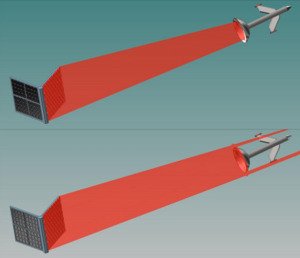
An alternative look at Maxwell’s result adopted for perfect reflection of
light from sail
Laser light
wafer scale
integrated spacecraft
Solar panel
sail
Photon picture:
Momentum, p, of a single photon of wavelength $λ$
$$p=ℏk=\frac{h}{λ}$$
$$p=N\frac{h}{λ}$$
for N photons
$$Δp=2 N\frac{h}{λ}$$
Momentum transfer of N reflected photons

Slide 25
$$N=\frac{U}{ℏω }=\frac{U}{hν}$$
Energy of N photons:
$$U=N ℏω$$
$$Δp=2 N\frac{h}{λ}=2\frac{U}{hν}\frac{h}{λ}=2\frac{U}{νλ}=2\frac{U}{c}$$
Let’s have a look at the non-relativistic approximation for photon driven propulsion in the limit of complete photon reflection
$$Δp=2\frac{U}{c}$$
$$Δp=(1+r)\frac{U}{c}$$
for complete photon reflection otherwise
with
r=0 (absorption)
r=1 reflection
0<r<1 in between
Newton’s second law
$$F=2\frac{\frac{dU}{dt}}{c}=\frac{2P}{c}$$
$$F=\frac{dp}{dt}$$
where P=laser power that hits the sail
$$a=\frac{F}{m}=\frac{2P}{mc}$$
Acceleration of spacecraft

Slide 26
The laser beam is not perfectly parallel but has divergence θ which depends, according to diffraction theory, on wavelength of the laser light and linear dimension, d, of the emitter
D_{s}/2
L
L=distance from laser to sail
$$\frac{D_{s}}{2L}≈θ≈\frac{λ}{d}$$
Physics of diffraction on circular aperture
with d=diameter of aperture (laser source)
Spot size at distance L from laser $D_{s}=\frac{2Lλ}{d}$
Eventually for very large L: $D_{s}>D$ and laser energy will be lost

Slide 27
We ask at which distance $L_{0}$is $D_{s}=D$
and what will be the speed of spacecraft at
this distance
$$D=\frac{2L_{0}λ}{d}$$
$$L_{0}=\frac{Dd}{2λ}$$
As long as all the laser power is used to propel the
Spacecraft force is constant and given by
$$F=\frac{2P}{c}$$
$$W=\int_{0}^{L_{0}}{F dL}=\frac{2PL_{0}}{c}=\frac{2P}{c}\frac{Dd}{2λ}=\frac{P}{c}\frac{Dd}{λ}$$
Work done on spacecraft
From work-kinetic energy theorem:
$$v=\sqrt{\frac{2P}{mc}\frac{Dd}{λ}}$$
$$\frac{1}{2}mv^{2}=\frac{P}{c}\frac{Dd}{λ}$$
Time it takes to reach this speed
$$t=\frac{\sqrt{\frac{2P}{mc}\frac{Dd}{λ}}}{a}=\frac{mc\sqrt{\frac{2P}{mc}\frac{Dd}{λ}}}{2P}=\sqrt{mc\frac{Dd}{2Pλ}}$$
$$v=a t$$

Slide 28
Let’s plug in numbers for optimistic example, the DE-STAR 4
(Directed Energy System for Targeting of Asteroids and ExploRation )
Laser power P=50 GW similar to the power of a conventional shuttle on launch
Laser sail D=1m
Modular laser diameter d=10km (DE-STAR 4 where 4 means d=10⁴m)
Mass of wafer m=1g
$λ=500$ nm (my assumption, did not find $λ$ of the suggested laser source,
alternatively use 1 μm for Yb Fiber laser )
$$v=\sqrt{\frac{2P}{mc}\frac{Dd}{λ}}=8.2×{10}^{7}\frac{m}{s}=27\% c$$
(max speed $\sqrt{2}$ higher)
$t=\sqrt{mc\frac{Dd}{2Pλ}}=245s=4$ min
paper estimates 10 min for
time to reach max speed
Note also that relativistic effects
not considered here create substantial error for v≈0.3c
Trip to Mars in approx. 30 min. and, most exciting,
Trip to Alpha Centauri in about 15 years

