Slide 1
Lattice Dynamics
related to movement of atoms
about their equilibrium positions
determined by electronic structure
Physical properties of solids
Sound velocity
Thermal properties: -specific heat
-thermal expansion
-thermal conductivity
(for semiconductors)
Hardness of perfect single crystals (without defects)

Slide 2
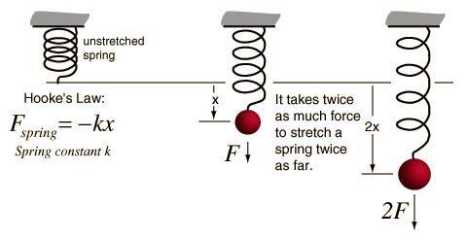
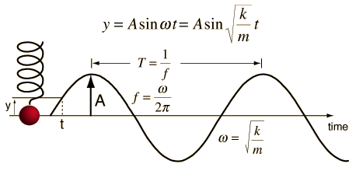
Reminder to the physics of oscillations and waves:
Harmonic oscillator in classical mechanics:
Equation of motion:
Example: spring pendulum
or
Hooke’s law
where
Solution with
where
Dx
X=A sin ωt
X
x

Slide 3
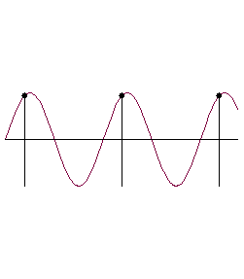
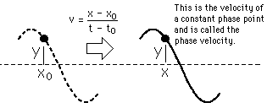
Traveling plane waves:
or
Y
in particular
X=0:
0
X
t=0:
Particular state of oscillation Y=const
travels according
solves wave equation

Slide 4
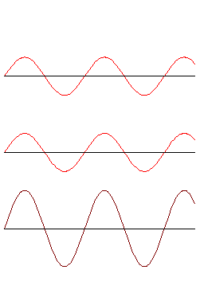
Transverse wave
Longitudinal wave
Standing wave

Slide 5
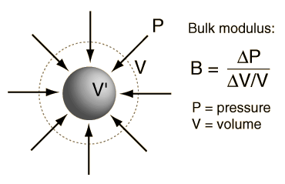
Large wavelength λ
λ>10⁻⁸m
10⁻¹⁰m
Crystal can be viewed as a continuous medium:
good for
Speed of longitudinal wave:
where B_{s}: bulk modulus
with
(ignoring anisotropy of the crystal)
B_{s} determines elastic deformation energy density
compressibility
(click for details in thermodynamic context)
dilation
E.g.: Steel
B_{s}=160 10⁹N/m²
ρ=7860kg/m³

Slide 6
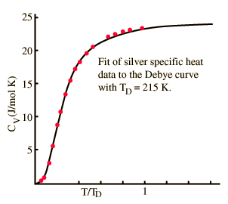
λ>> interatomic spacing
continuum approach fails
In addition:
vibrational modes quantized
phonons

Slide 7
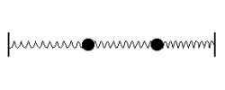
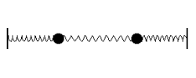
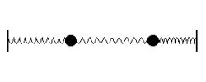
Vibrational Modes of a Monatomic Lattice
Linear chain:
Remember: two coupled harmonic oscillators
Symmetric mode
Anti-symmetric mode
Superposition of normal modes

Slide 8
generalization
Infinite linear chain
?
How to derive the equation of motion in the harmonic approximation
n-2
n-1
n
n+1
n+2
D
a
u_{n-2}
u_{n-1}
u_{n}
u_{n+1}
u_{n+2}
u_{n-2}
u_{n-1}
u_{n}
u_{n+1}
u_{n+2}
fixed

Slide 9
Total force driving atom n back to equilibrium
n
n
Alternative without thinking
Lagrange formalism
equation of motion
Solution of continuous wave equation
?
approach for linear chain
Let us try!
,
,

Slide 10
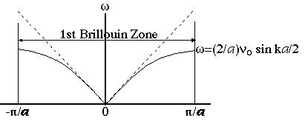
Note: here pictures of transversal waves
although calculation for the longitudinal case
k
Continuum limit of acoustic waves:

Slide 11
k
, here h=1
1-dim. reciprocal
lattice vector G_{h}
Region
is called
first Brillouin zone

Slide 12
Brillouin zones
We saw: all required information contained in a particular volume in reciprocal space
a
first Brillouin zone
1d:
where m=hn integer
1st Brillouin zone
In general: first Brillouin zone
Wigner-Seitz cell of the reciprocal lattice

Slide 13
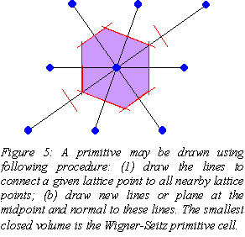

Slide 14
Vibrational Spectrum for structures with 2 or more atoms/primitive basis
Linear diatomic chain:
2n-2
2n-1
2n
2n+1
2n+2
D
a
2a
u_{2n-2}
u_{2n-1}
u_{2n}
u_{2n+1}
u_{2n+2}
Equation of motion for atoms on even positions:
Equation of motion for atoms on even positions:
Solution with:
and

Slide 15
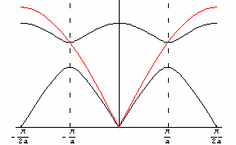
Click on the picture to start the animation M->m
note wrong axis in the movie
2
2
,

Slide 16
Optic Mode
Atomic Displacement
Click for animations
Acoustic Mode
Atomic Displacement

Slide 17
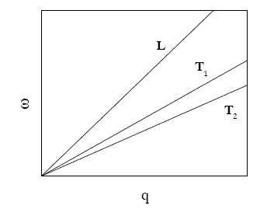
Dispersion curves of 3D crystals
3D crystal: clear separation into longitudinal and transverse mode only possible in
particular symmetry directions
Every crystal has 3 acoustic branches
sound waves
of elastic theory
1 longitudinal
2 transverse
acoustic
Every additional atom of the primitive basis
further 3 optical branches
again 2 transvers
1 longitudinal
p atoms/primitive unit cell ( primitive basis of p atoms):
3 acoustic branches
+ 3(p-1) optical branches
= 3p branches
1LA +2TA
(p-1)LO +2(p-1)TO

Slide 18
z
y
Intuitive picture:
1atom
3 translational degrees of freedom
x
3+3=6 degrees of freedom=3 translations+2rotations
+1vibraton
# atoms
in primitive
basis
# of primitive
unit cells
Solid: p N atoms
3p N vibrations
no translations, no rotations

Slide 19
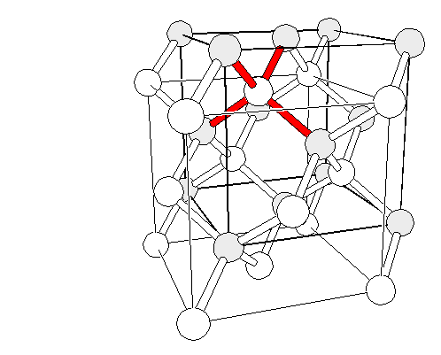
Part of the phonon dispersion relation of diamond
2 fcc sublattices vibrate against one another
However, identical atoms
no dipole moment
Longitudinal Optical
Transversal Optical
degenerated
Longitudinal Acoustic
(0,0,0)
Transversal Acoustic
diamond lattice: fcc lattice with basis
P=2
degenerated
2x3=6 branches expected

Slide 20
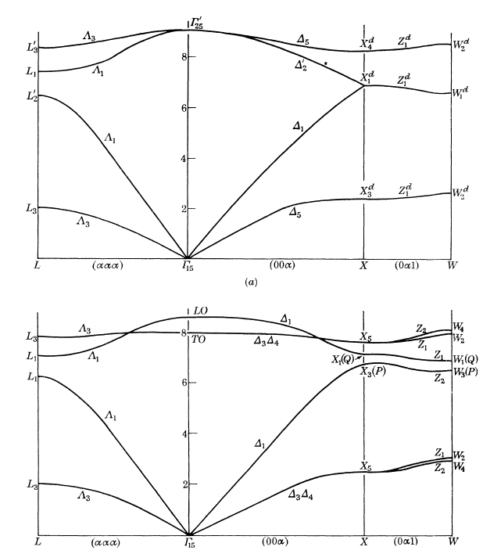
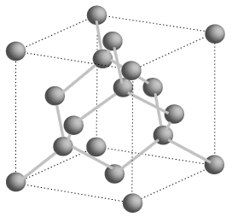
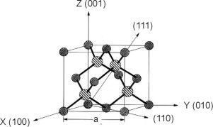
Calculated phonon dispersion relation
of Ge (diamond structure)
Calculated phonon dispersion relation
of GaAs (zincblende structure)
Adapted from:
H. Montgomery, “ The symmetry of lattice vibrations in zincblende and diamond structures”, Proc. Roy. Soc. A. 309, 521-549 (1969)

Slide 21
Phonon spectroscopy
Inelastic interaction of light and particle waves with phonons
Constrains: conservation law of
momentum
energy
Condition for
in
elastic
scattering
in
elastic
sattering
± q
scattered wave
Reciprocal lattice
vector
for photon
scattering
incoming wave
phonon
wave
vector
for neutrons
“quasimomentum”

Slide 23
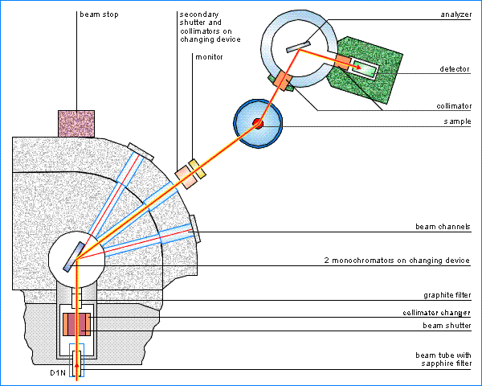
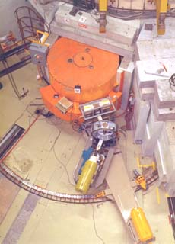
Triple axis neutron spectrometer
@ ILL in Grenoble, France

Slide 24
Very expensive and involved experiments
Table top alternatives
?
Yes, infra-red absorption and
inelastic light scattering (Raman and Brillouin)
However only
accessible
see homework #8
Lonely scientist in the reactor hall

