Slide 1
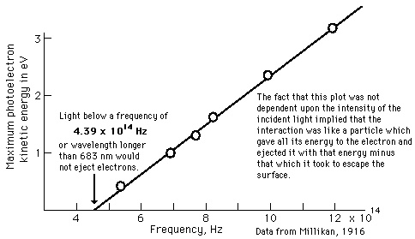
Bose systems: photons, phonons & magnons
Photons* and Planck’s black body radiation law
*For a formal derivation of photons via quantization of the EM field see, e.g.,
http://en.citizendium.org/wiki/Quantization_of_the_electromagnetic_field
Einstein Nobel prize 1921
Existence of photons
Plot from
Our goal: Using photon interpretation to
understand
2πν with
ν=frequency
Planck’s const./2π
Energy of the quantum
Energy per unit volume
of the radiation emitted in the frequency range [ν, ν+dν]

Slide 2
Standing EM waves = modes characterized by wave vector k
of plane wave solutions
Each mode can be occupied with a certain # n_{k,s} of photons
n_{k,s} of photons → classical amplitude of the standing wave
s=1,2 takes into account the two linear independent polarizations
With this and the individual photon energies
Total energy in the cavity
Index of a particular microstate characterized by the occupation #s
with
Let’s first take advantage of the fact that we know the Bose-Einstein distribution function already

Slide 3
We derive the same result with the partition function of the canonical ensemble
Energy fluctuations
With
Of course consistent with U=F+TS
when using F=-k_{B}T lnZ
and
With

Slide 4
The dispersion relation for light propagating in vacuum reads:
speed of light
Reveals: light frequency is independent of the polarization state s and the
direction of propagation
Let’s evaluate the k-sum
If we impose periodic boundary conditions for the electric field wave
such that

Slide 5
# of modes between k and k+dk
Density of states in k-space
We will learn other techniques to calculate the density of states for more complicated dispersion relations.
With:
Defining the energy density
Internal energy of the box at T, relative to the vacuum energy (e.g., responsible for the Casimir effect)
with
with

Slide 6
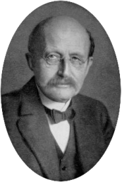
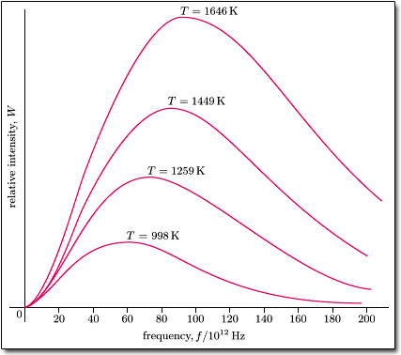
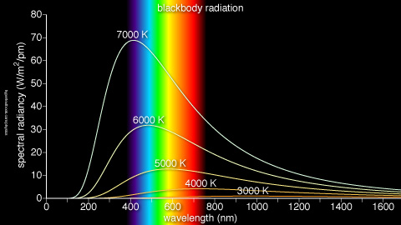
If we asked for the spectrally resolved
we obtain from inspection of
Planck’s spectral energy density
Image from: http://en.wikipedia.org/wiki/File:Max_Planck.png
It is useful to write it down with the differential to remember how to do the correct transformation to

Slide 7
For experimental comparison we need to know not what is the spectral energy density insight the box, but what radiates out into one hemisphere:
z
Photons leaving the hole in direction θ
in the time Δt come out of max depth of
A
c
#Photons leaving the hole in direction θ in time Δt
Lambert’s
cosine law*
Fraction of photons in solid angle dΩ=sinθdϕdθ is
Energy emitted into hemisphere in time Δt
With sinθ=x

Slide 8
The emitted intensity is defined emitted energy per area A and time Δt
With
Celebrated Stefan-Boltzmann law
A second look at the derivation of Planck’s law
# of modes with frequency [ω,ω+d ω]
Photon energy
# of photons excited in each mode

Slide 9
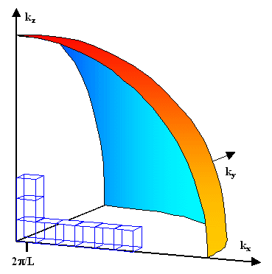
The concept of density of states
Continuous volume element in isotropic k-space
Region in k-space occupied by a quantized state:
ky
kx

Slide 10
From density of states in k-space to density of states in energy or frequency space
With dispersion relation, here for photons
and
Simple substitution yields
However, k-space not always isotropic
more general approach
Property: when integrating over [ω, ω+d ω] we obtain the number of states in this interval
Here

