Slide 1
Kinetic theory
We consider a dilute gas of N atoms in a box in the classical limit
<a>
de Broglie wave length λ
with density
Low density
classical limit
high temperature

Slide 2
Ideal gas equation of state
Momentum change during
collision with wall:
L
Average perpendicular force component
acting on particle during time interval Δt
x
Average perpendicular force component acting on wall during time interval Δt

Slide 3
Time of flight Δt between successive collisions with right wall:
with
Total force exerted on the wall by N particles
Pressure P on right wall of area A=L_{y}L_{z}
Same argument for particles flying
in y-direction
in z-direction

Slide 4
Further inspection of
with
and
arithmetic average
Mean square velocity
Compare with the ideal gas equation of state
Correct only in the classical limit
See textbook for generalized expressions where m_{i} are not identical

Slide 5

Note: we did not derive yet the equation of state
To do so we need to show
Calculation of statistical averages requires knowledge of the
distribution function:
:number of molecules at a given time, t, within a
volume element d³r located at r and
momentum element d³p around p=mv
Note that (r, p) spans the 6-dimensional µ-space where f is defined. Later we will introduce a density function ρ defined over the 6N-dimensional Γ-space. Don’t confuse!!!
With f we are able to calculate averages such as:
For

Slide 6
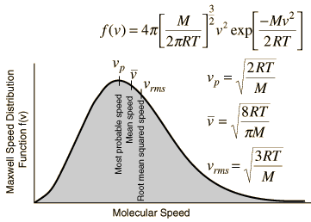
How to get f ?
In equilibrium, f turns out to be the
Maxwell-Boltzmann distribution function
We will encounter various approaches for its derivation throughout the course.
Let’s start with a heuristic consideration
Remember the barometric formula P=P(h)
h
A
Mass of the air contained in the volume element
Δh

Slide 7
h
air in good approximation considered as an ideal gas
In the case T=const. and with M=nN_{A}m and R=N_{A}k_{B}
and

Slide 8
= number of particles in d³r ∝ probability of finding a particle in d³r
in accordance with our definition of f we expect
Ansatz
1

Slide 9
with
velocity distribution
independent of position
Let’s calculate the Maxwell Boltzmann distribution f₁(p²) with all constants

Slide 10
with

Slide 11
When asking for the probability, f(v), of finding a particle with velocity between
and we transform from d³p to dv
f(v)
Maxwell speed distribution function
With, e.g., f(p) at hand we can actually derive the ideal gas equation of state
by calculating

Slide 12
with

