Slide 1
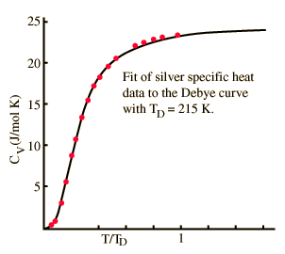
The equipartition theorem:
a classical but sometimes useful result
Goal: understanding why in the classical limit the average energy associated with any
momentum or position variable appearing quadratically in one term of the
Hamiltonian* is ½ k_{B}T
There is a more general form of the equipartition theorem which we don’t consider due to the limitations of
the classical approximation in first place
Example for usefulness:
c_{V}-> 3R Dulong-Petit limit
Photons* and Planck’s black body radiation law
We start from a system with dynamics determined by Hamiltonian:
where u is one of the general coordinates q₁, p₁, · · · , q_{3N} , p_{3N} , and H’ and K are independent of u

Slide 2
Next we show for :
The thermal average is evaluated according to:
with

Slide 3
Let’s apply equipartition theorem to the Hamiltonian describing the lattice vibrations
of a solid in harmonic approximation
3N momentum variables appearing quadratically in H
3N position variables appearing
quadratically in H
6N degrees of freedom each contributing with
model independent classical limit
Dulong-Petit limit

Slide 4
Equipartition theorem (classical approximation) is only valid when the typical
thermal energy k_{B}T greatly exceeds the spacing between quantum energy levels:
Heat capacity of diatomic gases:
an example for application and limitation of the equipartition theorem
Let’s consider N non-interacting H₂ molecules in harmonic approximation
N- molecule Hamiltonian
Single molecule Hamiltonian H_{s} reads
with
for, e.g., H₂ molecule
Here already we can see that in the harmonic approximation we will have 7
terms quadratically entering H_{s}
each molecule contributes with

Slide 5
For a closer look we separate out center of mass motion and introduce spherical coordinates for the relative motion
Let’s start from the single molecule Lagrangian
and introduce the center of mass
with M=m₁+m₂
and
where µ is the reduced mass
With L we derive the canonic conjugate momentum variables
and

Slide 6
We express the Hamiltonian and Lagrangian in the new variables:
center of mass motion
relative motion
Since
spherical symmetric
express
in spherical coordinates
With
Together with
calculated from

Slide 7
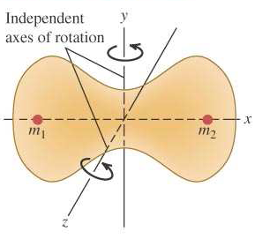
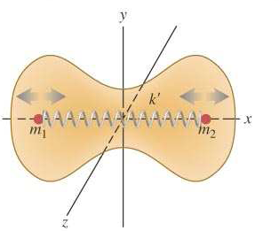
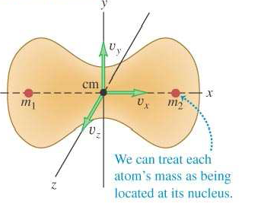
rotational contribution
vibrational contribution
Total Hamiltonian:

Slide 8
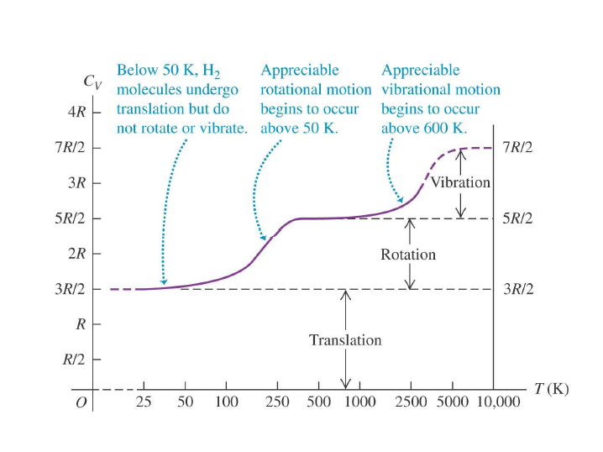
The activation of all degrees of freedom requires remarkable high temperatures
Large quantum effects whenever level spacing
not fulfilled
vibrations are frozen out when

