Slide 1
Boltzmann transport equation and H-theorem
Aim of kinetic theory: find the distribution function
for a given form of particle-particle interaction
Special case
equilibrium distribution
equilibrium thermodynamics
Find the equation of motion for the distribution function
Consider a collisionless free flow (no force) in x direction for time δt
x
x₁
x₂
X’₁
X’₂

Slide 2
# of particles in (x’,x’+dx’) with (p_{x,}p_{x}+dp_{x})
flowing into dx’dp_{x}
# of particles in (x,x+dx) with (p_{x,}p_{x}+dp_{x})
leaving phase space element dxdp_{x}
dx’=dx
dx’dp_{x}=dx dp_{x}
Through linear expansion

Slide 3
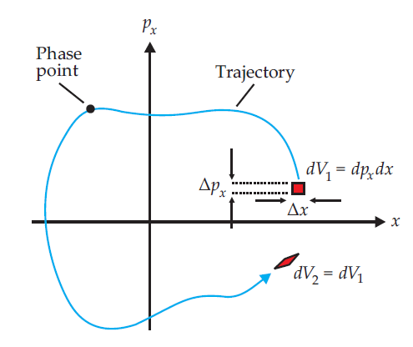

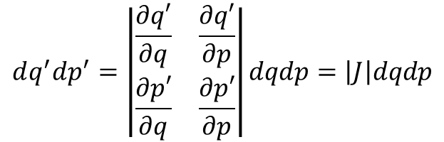
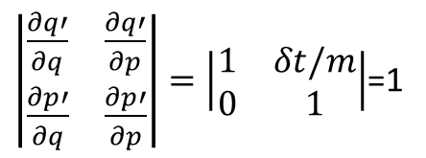

Now let’s generalize into full r-dependence and allow for an external force F
$$dq^{′}dp^{′}=\left|\begin{matrix}\frac{∂q′}{∂q} & \frac{∂q′}{∂p} \\ \frac{∂p′}{∂q} & \frac{∂p′}{∂p}\end{matrix}\right|dqdp=\left|J\right|dqdp$$
= Liouville’s theorem
Jacobian determinant J=1 for
canonical transformations
(leaving Hamilton equations unchanged)
$$q^{′}=q\left(t+δt\right)=q+\frac{p}{m}δt$$
$\left|\begin{matrix}\frac{∂q′}{∂q} & \frac{∂q′}{∂p} \\ \frac{∂p′}{∂q} & \frac{∂p′}{∂p}\end{matrix}\right|=\left|\begin{matrix}1 & δt/m \\ 0 & 1\end{matrix}\right|$=1
Here:
$$p^{′}=p\left(t+δt\right)=p+Fδt$$
So far we ignored particle-particle collisions
change of f due to collisions
Celebrated Boltzmann
transport equation.
Very useful in CMP.

Slide 4
Detailed analysis of the transport equation is beyond the scope
of this course (see e.g., Kerson Huang, Statistical Mechanics, John Wiley&Sons,New York 1987, p. 60 )
We discuss briefly implications for statistical mechanics
Equilibrium:
-absence of an external force
-homogenous density
0
Boltzmann distribution
Solving
only binary collisions (dilute gas)
- influence of container walls neglected
- velocities of colliding particles are
uncorrelated & independent of position
(molecular chaos or Stosszahlansatz)
with assumptions

Slide 5
H-theorem
Boltzmann defined the functional
H-theorem:
If at a given time t the state of a gas satisfies the assumption of
molecular chaos, then at t+ε (ε->0)
if and only if f(p,t) is the Maxwell-Boltzmann distribution
Points where molecular
chaos is fulfilled
Note: it seems as if the H-theorem
explains the time asymmetry
from time inversion symmetric
microscopic descriptions.
This is not the case, assumption of
molecular chaos is the origin of time
asymmetry.
H
H(t) calculated with f
solving Boltzmann
Transport equation
t

