Slide 1
Insights from electric current applied in Theory of Traffic
Simple model of traffic flow on long crowded roads*
*M. J. Lighthill and G. B. Whitham, Proc. R. Soc. Lond. A 1955 229, (1955)
Rather than electrons flowing in a wire we look at flow of cars on a road
-It makes sense to introduce again a flow $j=n v$
where n is the concentration of cars and $v$ is the space-mean speed
Let’s have a closer look how to measure j, n, and v.
$$Δx$$
Wait a long time $τ$ for N vehicles
to pass through slice $Δx$
How to measure j
$$j=N/τ$$

Slide 2
Concentration $n$
$$Δx$$
Let $Δt_{i}$be the time it takes for a
car i to cross the slice $Δx$
$\sum_{i=1}^{N}{Δt_{i}}$ is the time cars have been present in the slice $Δx$ during observation time $τ$
$\frac{\sum_{i=1}^{N}{Δt_{i}}}{τ}$ average number of vehicle on the slice of the road
Concentration $n=\frac{\sum_{i=1}^{N}{Δt_{i}}}{τ Δx}$ number of vehicle per unit length of the road
Space-mean speed $v$:
$$v=\frac{Δx}{\overline{Δt}}=\frac{Δx}{\frac{1}{N}\sum_{i=1}^{N}{Δt_{i}}}=\frac{N}{τn}=\frac{j}{n}$$
same transport equation
we use for electric current density

Slide 3
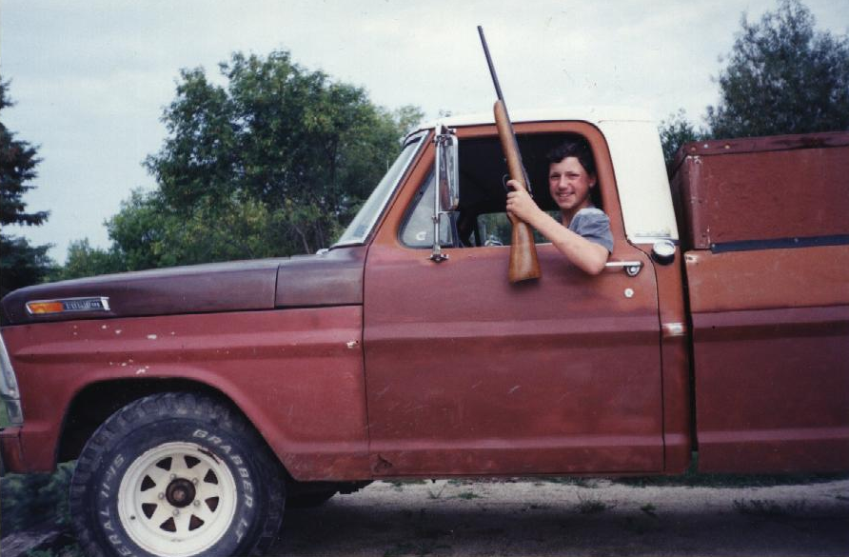
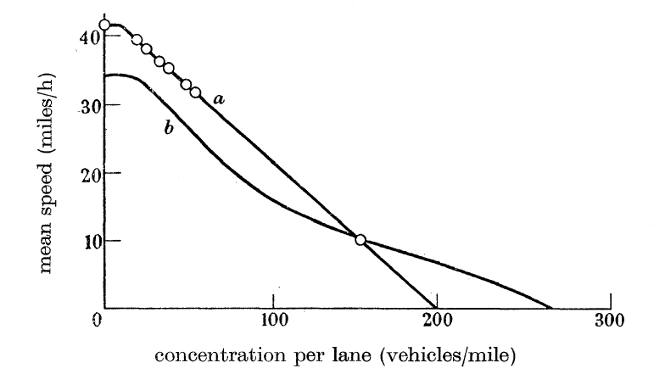
How does flow depend on concentration?
Is there a maximum flow? If so, how to get there?
Simple minded driver may think:
If everyone just drives faster, flow is increased
That would be true if concentration, n,
is independent of speed, but it is not.
The faster you drive the more distance to the car in front of you is needed
because the faster you drive the more path it takes to slow down or stop.
Empirical data $v$ vs $n$ showing how drivers behave
(not even close to safe driving)
$$v=v_{free}−m n$$
Data from:
Greenshields, B. D. 1935
A study of traffic capacity.
Proc. Highw. Res. Ed, Wash., 14, 448.

Slide 4
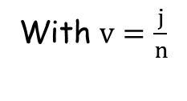
$$v=v_{free}−m n$$
With $v=\frac{j}{n}$
$$j=n(v_{free}−m n)$$
$$n=0$$
or
$$n_{jam}=\frac{v_{free}}{m}$$
$$n\left(v_{free}−m n\right)=0$$
$$\frac{dj}{dn}=v_{free}−2mn=0$$
$$n_{max}=\frac{v_{free}}{2m}$$
$$j=\left(40\frac{miles}{h}−\frac{1}{5}\frac{miles^{2}}{h vehicles} n\right)n$$
$$n_{max}$$
$$n_{jam}$$
Regulating speed to $v\left(n_{max}\right)=\frac{v_{free}}{2}$ can maximize the flow.

