Slide 1
Social Security: With You Through Life’s Journey… University of Nebraska - Lincoln
April 2024
Produced at U.S. taxpayer expense

Slide 2
Disclaimer
This information is current at the time of the presentation, but Social Security policy is subject to change. Please visit SSA.gov for up-to-date information on our programs.

Slide 3
Agenda
Retirement & Spouse’s Benefits
Survivor Benefits
Medicare Enrollment & Filing Options
Online Services & my Social Security
Questions & Answers

Slide 4
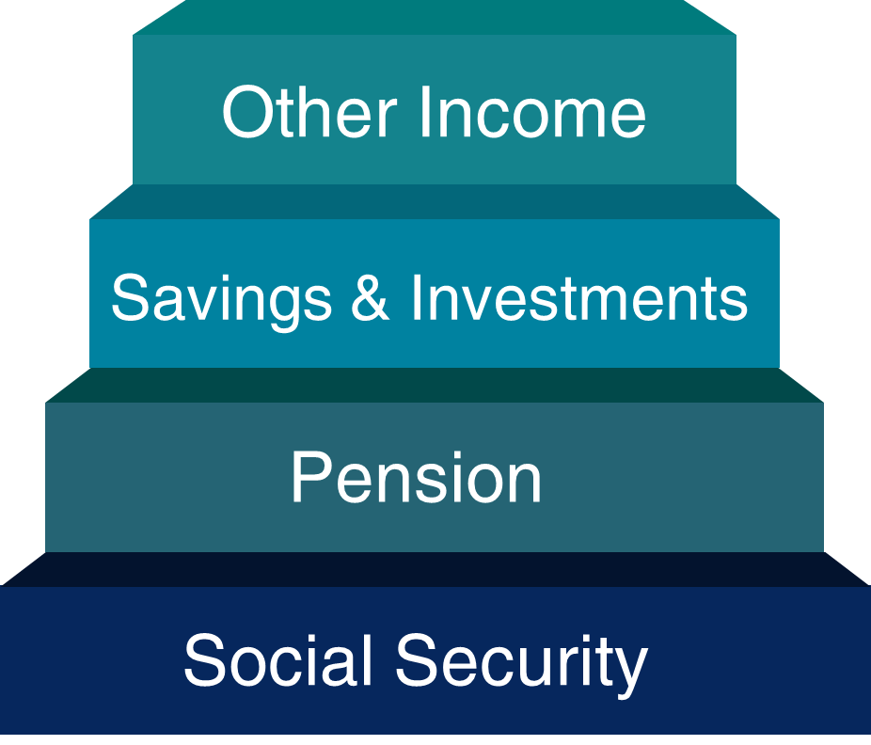
Three Legged Stool

Slide 5
What is FICA?
Stands for Federal Insurance Contributions Act
May show on paycheck as OASDI or Social Security
Federal payroll tax deducted from workers’ paychecks, matched by employer, and reported by employer to IRS
Total FICA tax = 15.3% of gross wages. You and your employer each pay 7.65%
6.2% for Social Security
1.45% for Medicare
FICA taxes help fund Social Security retirement, disability, survivor benefits and Medicare health insurance

Slide 6
How Do You Qualify for Retirement Benefits?
By earning “credits” when you work and pay Social Security taxes
You need 40 credits (10 years of work) and you must be 62 or older
Each $1,730 in earnings gives you one credit
You can earn a maximum of 4 credits per year
Note: To earn 4 credits in 2024, you must earn at least $6,920.
ssa.gov/planners/credits.html

Slide 7
How Social Security Determines Your Benefit
Benefits are based on earnings
Step 1 - Your wages are adjusted for changes in wage levels over time
Step 2 - Find the monthly average of your 35 highest earnings years
Step 3 - Result is “average indexed monthly earnings”
ssa.gov/OACT/COLA/Benefits.html

Slide 8
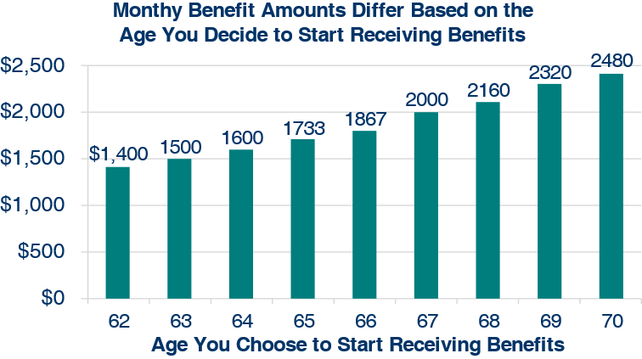
What Is the Best Age to Start Receiving Social Security Retirement Benefits?
Note: This example assumes a benefit of $2,000 at a full retirement age of 67

Slide 9
Benefits Chart by Age
Year of Birth | Full Retirement Age (FRA) | A retirement benefit taken at age 62 would be reduced by
1943-1954 | 66 | 25%
1955 | 66 and 2 months | 25.83%
1956 | 66 and 4 months | 26.67%
1957 | 66 and 6 months | 27.5%
1958 | 66 and 8 months | 28.33%
1959 | 66 and 10 months | 29.17%
1960 + | 67 | 30%
ssa.gov/oact/quickcalc/earlyretire.html

Slide 10
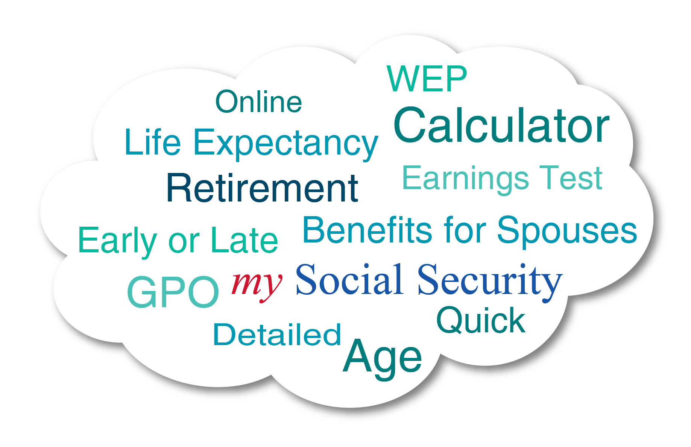
Social Security’s Online Calculators
ssa.gov/planners/calculators/

Slide 11
Benefits for the Family
Child | May receive benefits if unmarried and younger than age 18, or between ages 18 and 19 and a full-time student (no higher than grade 12)
Disabled Adult Child | May receive benefits after age 18 if unmarried and disabled before age 22
Spouse / Divorced Spouse | Must be age 62 OR caring for a child that is under age 16 or disabled If filing as a divorced spouse: You must be unmarried Marriage lasted at least ten (10) years Your ex-spouse must be at least 62 or entitled to disability benefits

Slide 12
Benefits for a Spouse
Maximum benefit = 50% of worker’s unreduced benefit
Reduction for early retirement
Benefit is unreduced if spouse is caring for worker’s child younger than age 16 or disabled
Does not reduce payment to the worker
Spouse benefits are not payable until worker collects
If spouse’s own benefit is less than 50% of the worker’s, they will be combined to equal to 50% of the worker’s
ssa.gov/planners/retire/yourspouse.html

Slide 13
Spousal Benefits – Example
Franklin’s Benefit at FRA
$2,000
$2,000
Max Spouse Benefit
$1,000
$1,000
Eleanor’s Own Benefit at FRA
$800
$1,200
Spouse Benefit Payable
$200
$0
Example 1
Example 2
NOTE: Benefits are reduced if filing prior to full retirement age (FRA).

Slide 14
We’re There If You Lose A Loved One

Slide 15
Survivor Benefits
Child | May receive benefits if unmarried and younger than age 18, or between ages 18 and 19 and a full-time student (no higher than grade 12)
Disabled Child | May receive benefits after age 18 if unmarried and disabled before age 22
Widow/er or Divorced Widow/er (Remarriage after age 60 will not affect benefits) | May receive full benefits at full retirement age or reduced benefits: as early as age 60 as early as 50, if disabled at any age if caring for child of deceased worker who is under age 16 or disabled and receives child's benefits
ssa.gov/planners/survivors

Slide 16
Spouse vs. Surviving Spouse Benefits
Spouse (living) | Surviving Spouse (deceased)
May start as early as age 62 | May start as early as age 60 or as early as 50 if disabled
50% if you wait until FRA or later | 100% if you start at FRA or later
Must file for benefits on own record and for spousal benefits at the same time if eligible | May draw benefits on one record and delay filing on the other to allow growth. Can switch to the higher benefit later.
ssa.gov/planners/survivors/ifyou.html

Slide 17
Working While Receiving Benefits
If you are | You can make up to | If you earn more, some benefits will be withheld
Under Full Retirement Age | $22,320/yr. | $1 for every $2
The Year Full Retirement Age is Reached | $59,520/yr. before month of full retirement age | $1 for every $3
Month of Full Retirement Age and Above | No Limit | No Limit
Retirement Earnings Test Calculator:
ssa.gov/OACT/COLA/RTeffect.html

Slide 18
Working While Receiving Benefits
Earnings that Count
Gross wages from employment
Net earnings from self-employment
Special Payments (sick/vacation pay, severance, bonuses, etc.)
for work done before you start getting benefits may or may not count.

Slide 19
Taxation of Social Security Benefits
Your adjusted gross income + Nontaxable interest + ½ of your Social Security benefits = Your “combined income”
Publication 554, Tax Guide for Seniors
Publication 915, Social Security and Equivalent Railroad Retirement Benefits
IRS.gov

Slide 20
Will I pay federal taxes on my benefits?
If you:
file a federal tax return as an "individual" and your combined income* is
between $25,000 and $34,000, you may have to pay income tax on up to 50 percent of your benefits.
more than $34,000, up to 85 percent of your benefits may be taxable.
file a joint return, and you and your spouse have a combined income* that is
between $32,000 and $44,000, you may have to pay income tax on up to 50 percent of your benefits
more than $44,000, up to 85 percent of your benefits may be taxable.
are married and file a separate tax return, you will probably pay taxes on your benefits.

Slide 21
Medicare
Original Medicare | Medicare Advantage (aka Part C)
Part A (Hospital Insurance) Part B (Medical Insurance) | Part A (Hospital Insurance) Part B (Medical Insurance)
You can add: Part D (Prescription Drug Plan) | Most plans include: Part D (Prescription Drug Plan) Extra Benefits (e.g. vision, hearing, dental, and more)
You can also add: Supplemental insurance coverage (Medigap) | Some plans also include: Lower out-of-pocket costs
Medicare.gov

Slide 22
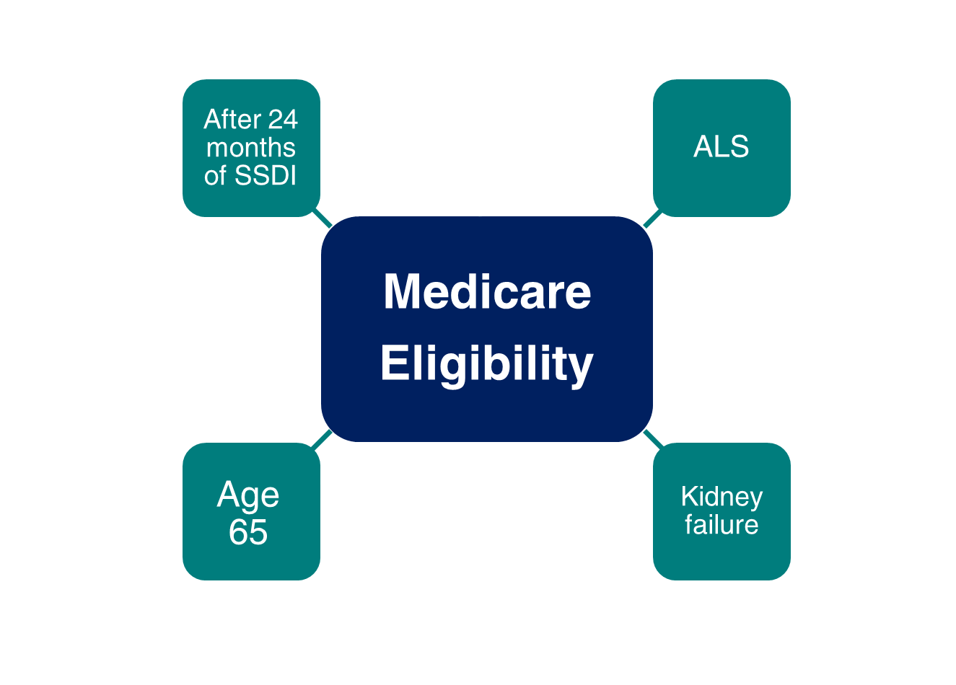
Medicare Eligibility

Slide 23
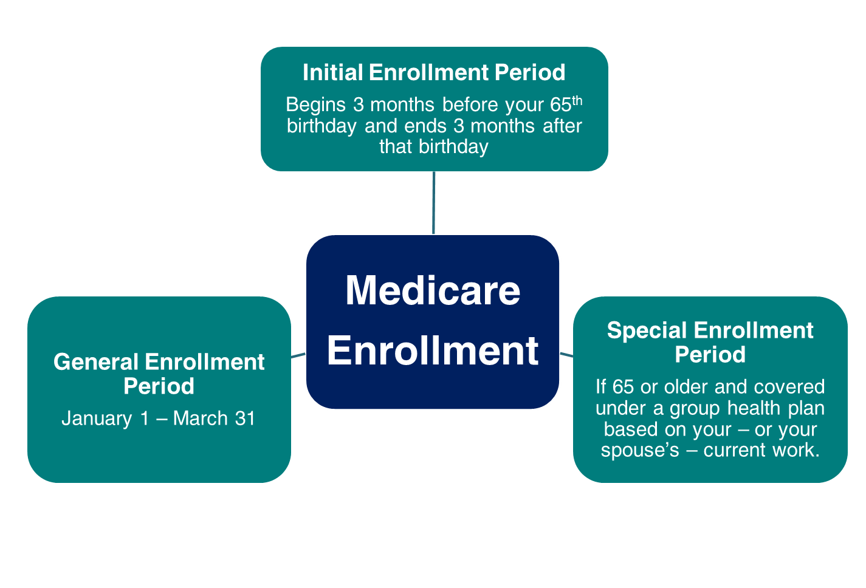
Medicare Enrollment
.

Slide 24
Medicare Part B Coverage - IEP
Beginning in 2023, if you enroll in the month of your Initial Enrollment Period: | Your Part B Medicare coverage starts:
One to three months before you reach age 65 | The month you turn age 65
The month you reach age 65, or one to three months after you reach age 65 | The first day of the month after you sign up

Slide 25
Medicare Part B Coverage - SEP
If you enroll in the month of your Special Enrollment Period: | Your Part B Medicare coverage starts:
Any time while you or your spouse have a group health plan based on current employment, or during the first full month you are no longer covered or employed | • On the first day of the month you enroll, or • By your choice, on the first day of any of the following 3 months
During any of the remaining 7 months of the SEP | The first day of the month after you sign up.

Slide 26
Medicare Part B Coverage - GEP
Beginning in 2023, if you enroll in the month of the General Enrollment Period: | Your Part B Medicare coverage starts:
January 1 to March 31 | The first day of the month after you sign up NOTE: Your monthly premium will go up 10% for each 12-month period you were eligible for Part B but didn’t sign up for it.

Slide 27
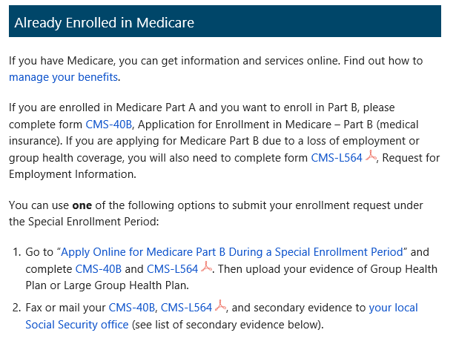
Medicare Applications
If you already have Medicare Part A and wish to add Medicare Part B, complete the online application, or fax or mail completed forms CMS-40B and CMS-L564/CMS-R-297 to your local Social Security office.
ssa.gov/benefits/medicare

Slide 28
Other Medicare Considerations
You are automatically enrolled in Parts A & B if you receive:
SS retirement / survivor benefits before age 65
SS disability benefits for 24 months
If you file after age 65, Part A may be retroactive up to 6 months but no earlier than age 65.
IRS does not allow HSA (health savings account) contributions while enrolled in Medicare.
ssa.gov/benefits/medicare/

Slide 29
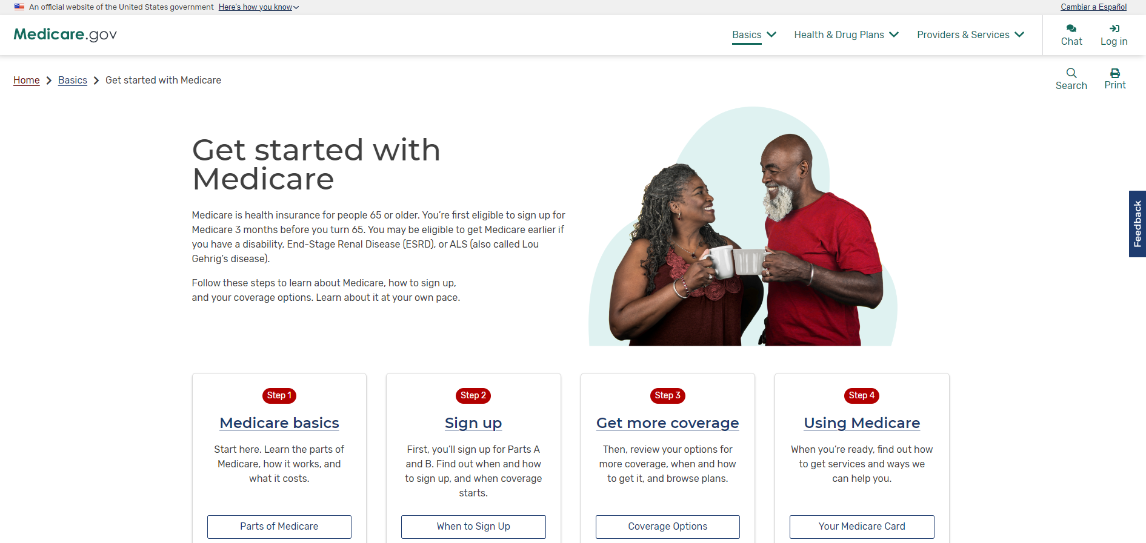
Medicare.gov
Create an account at Medicare.gov

Slide 30
How to Apply for Benefits
File online for Retirement, Spouse, Disability, or Medicare Only
If you are disabled, you can file for Retirement and Disability with same application if you are at least 62 but not yet FRA.
Survivor* application is not available online.
Schedule phone appointment at 1-800-772-1213, 8:00 a.m. – 7:00 p.m. Monday through Friday.
Schedule in-office appointment at 1-800-772-1213.
*Child and survivor claims can only
be done by phone or in the office.

Slide 31
Social Security Website
SocialSecurity.gov

Slide 32
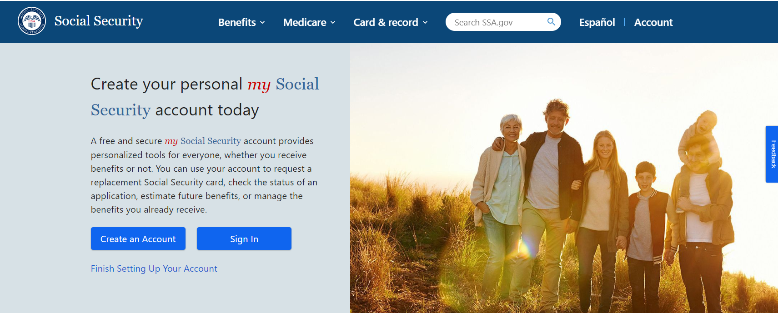
Open/Sign In to a my Social Security Account
ssa.gov/myaccount

Slide 33
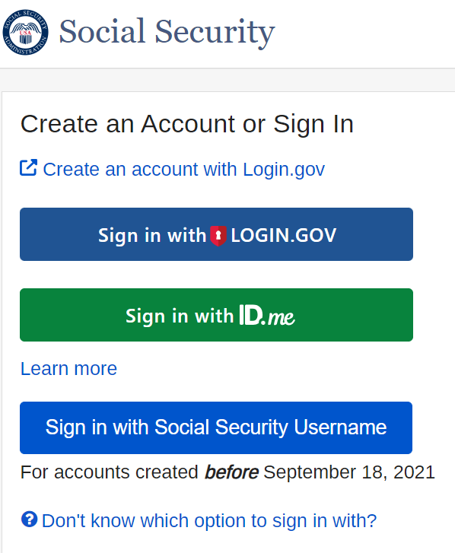
Open/Sign In to a my Social Security Account
If you already have an account:
Enter your existing username and password
Sign in using an existing Login.gov or ID.me credentials
To create a new account, select Create an Account and you will be directed to create a Login.gov account before proceeding.

Slide 34
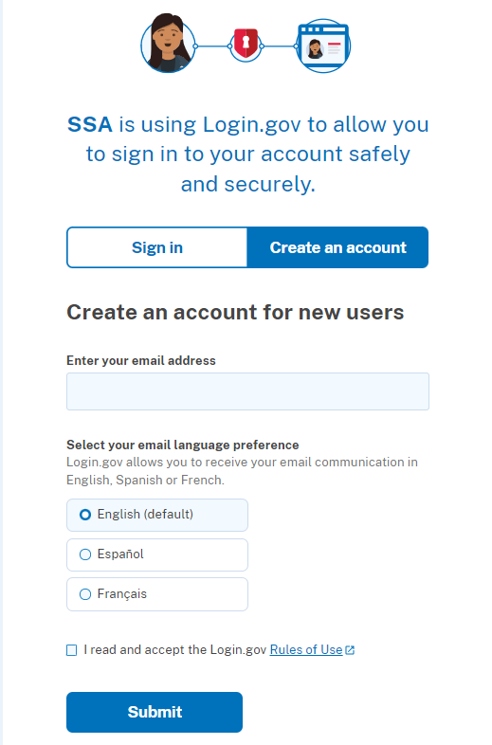
Open/Sign In to a my Social Security Account
Follow the steps to create a Login.gov account
You will be directed back to ssa.gov where you will provide personal information so we can verify your identity and agree to terms of service
Complete the registration process using the activation code we send you

Slide 35
my Social Security Services
If you do not receive benefits, you can:
View retirement benefit estimates at different ages or dates when you want to start receiving benefits;
View possible spouse’s benefits;
Request a replacement Social Security card if you meet certain requirements;
Check the status of your application or appeal;
Get a benefit verification letter as proof that you are not getting benefits;
Get your Social Security Statement to review:
Estimates of your future retirement, disability, and survivor benefits;
Your earnings record, to verify the amounts that we posted are correct; and
The estimated Social Security and Medicare taxes you’ve paid.
ssa.gov/myaccount/what.html

Slide 36
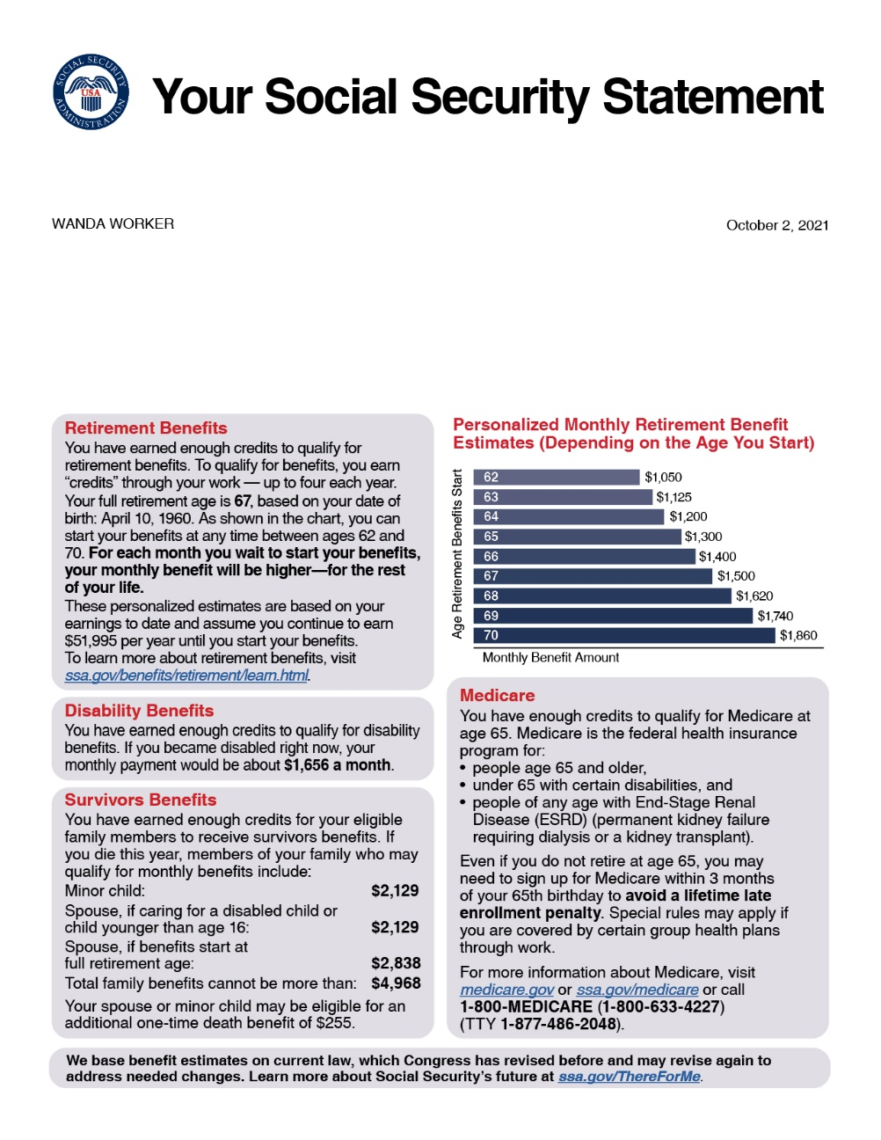
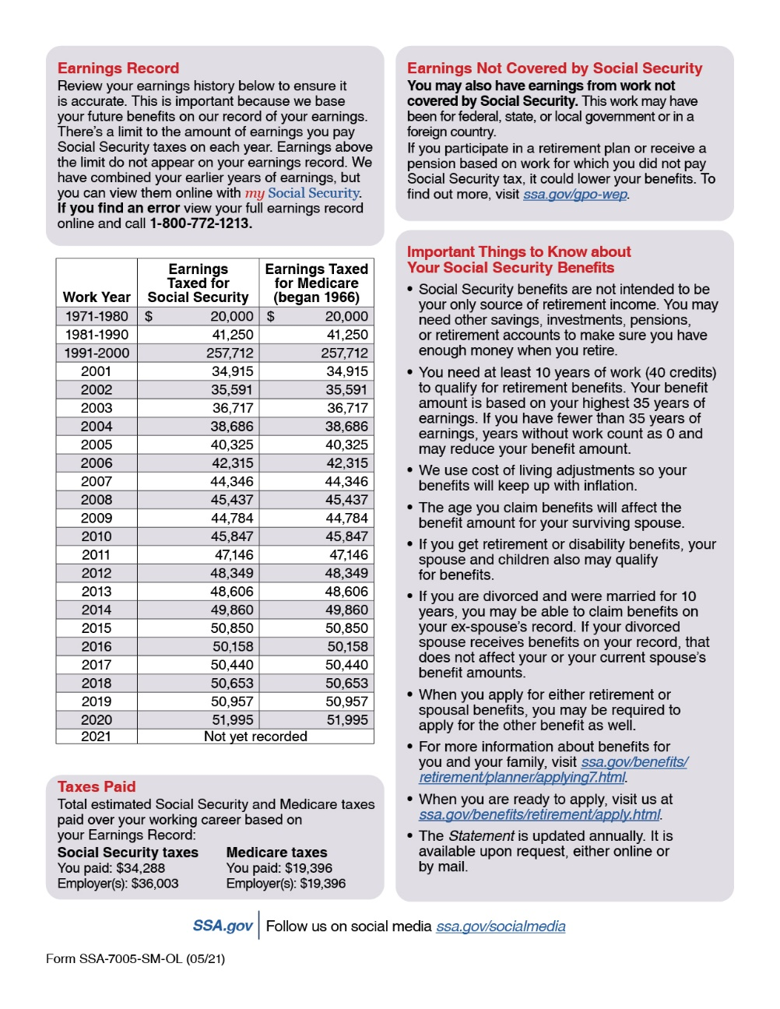
Social Security Statement

Slide 37
Advance Designation of Representative Payees
What is it?
Advance Designation of Representative Payees allows you to designate in advance up to three individuals who could serve as a representative payee for you, should the need arise.
Who is it for?
Adult and emancipated minor applicants and beneficiaries of Social Security or Supplemental Security Income, who do not have a representative payee.

Slide 38
Contact Us
Phone
National: 800-772-1213
TTY: 800-325-0778
Monday through Friday (8:00 a.m. to 7:00 p.m.)
In Person
Local Office: SSA.gov/locator
Online
Frequently Asked Questions: FAQ.SSA.gov

Slide 39
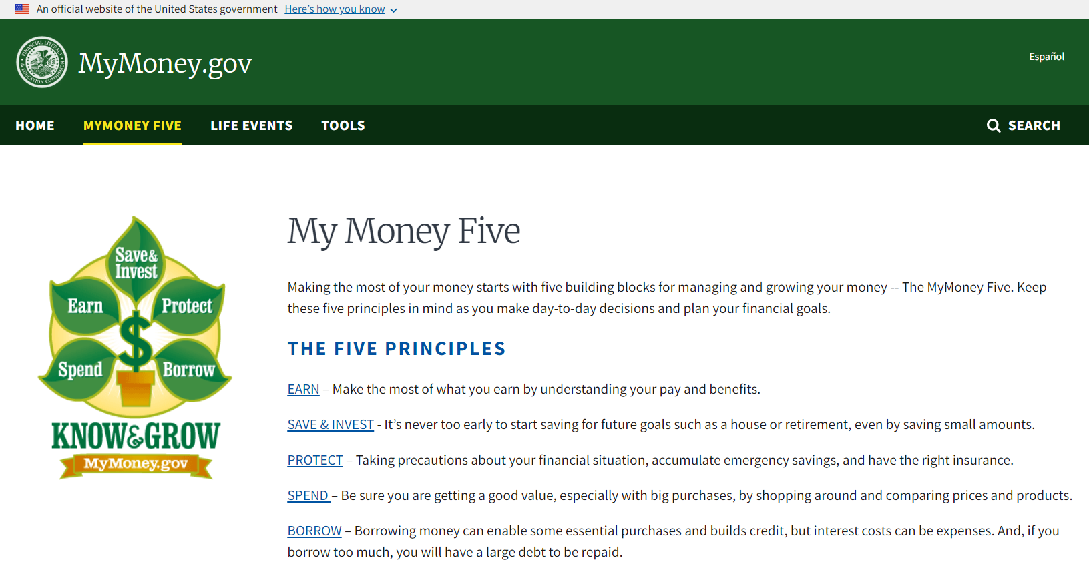
MyMoney.gov
mymoney.gov or 1-800-FED-INFO

Slide 40
Follow Us on Social Media!
@SocialSecurity

Slide 41
Q&A Session

